Slide 1
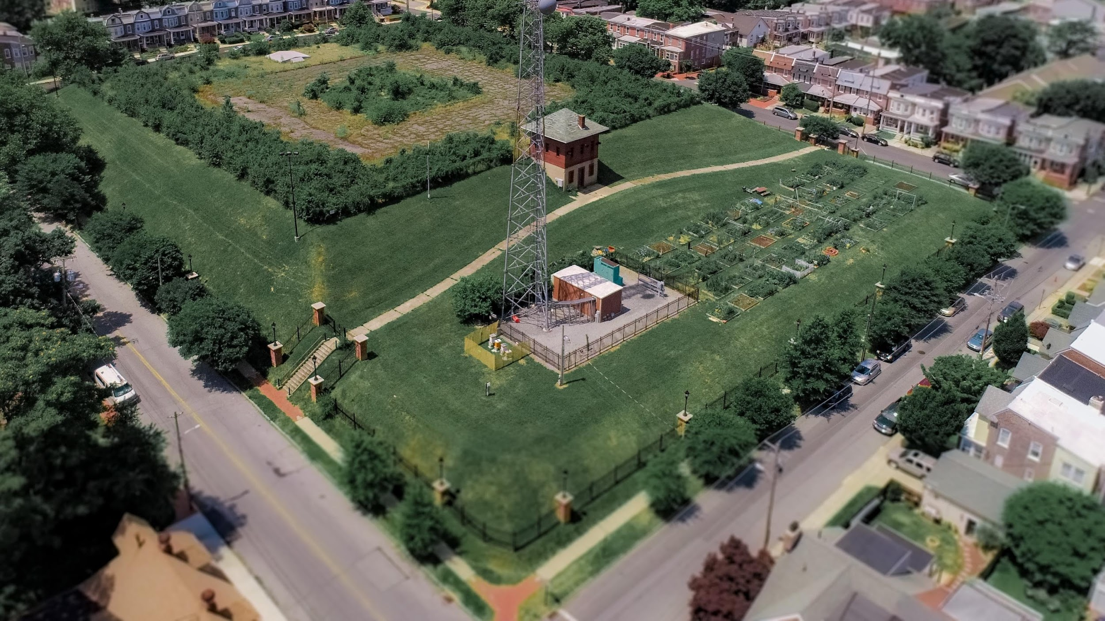
Community Development & Urban Planning Committee November 9, 2023

Slide 2
We are a neighborhood association made up of residents and other stakeholders in the area that surrounds the Rodney Reservoir.
Our goal is to keep the Rodney Reservoir:
safe
public
green
We are working together to create a future where all residents can enjoy its use.

Slide 3
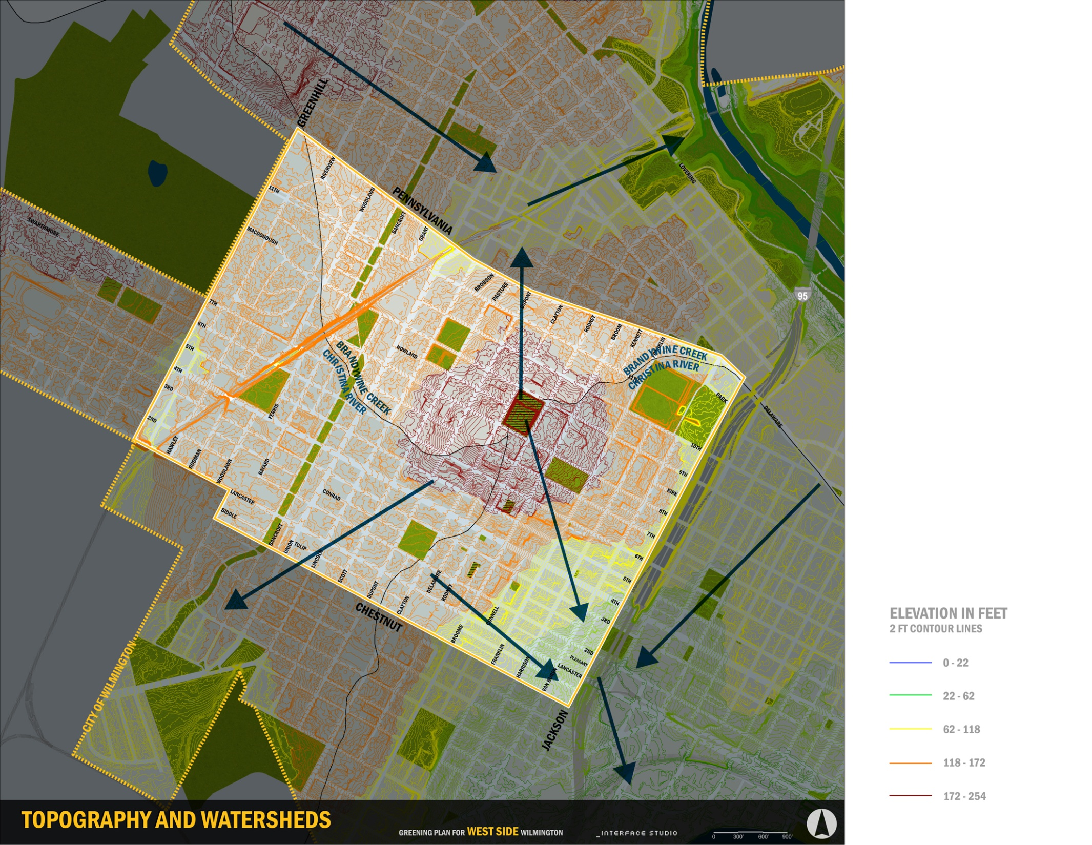
Rodney Reservoir: A Vital Green Space on the West Side
Site Features
3.78 acres
Zoned Open Space
Sits on a ridge at the meeting point of two watersheds
Natural elevation reaches ~235 ft above sea level
Meeting point of Hilltop, Little Italy and Cool Spring neighborhoods

Slide 4
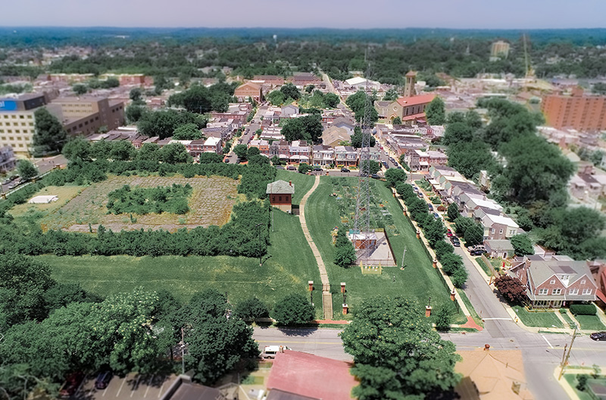

Slide 5
Rodney Reservoir: Buried water tank built in 1916 to serve
as part of the City’s water infrastructure
and be a public park.

Slide 6
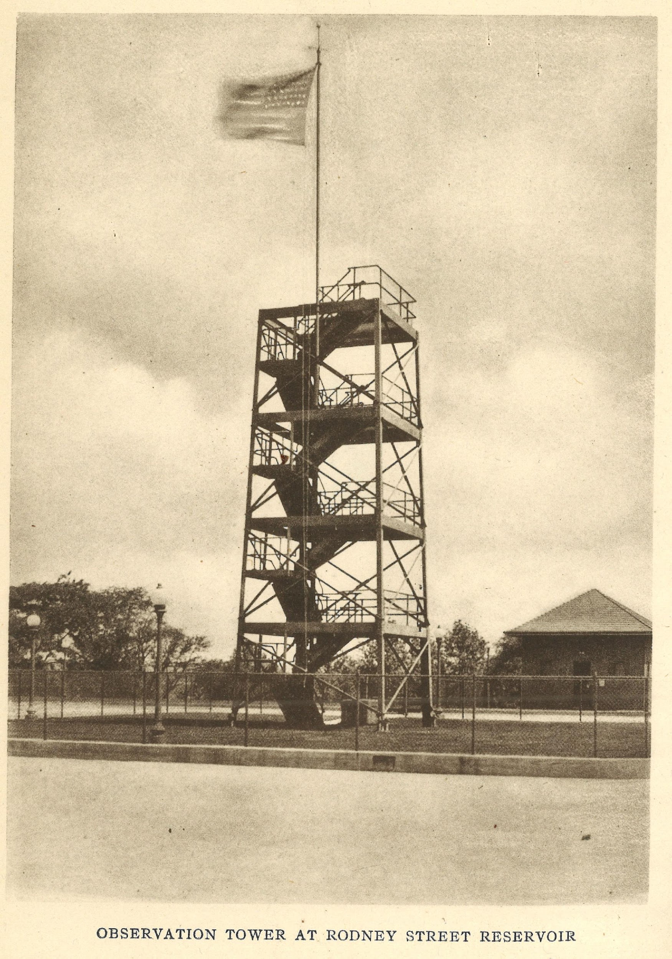
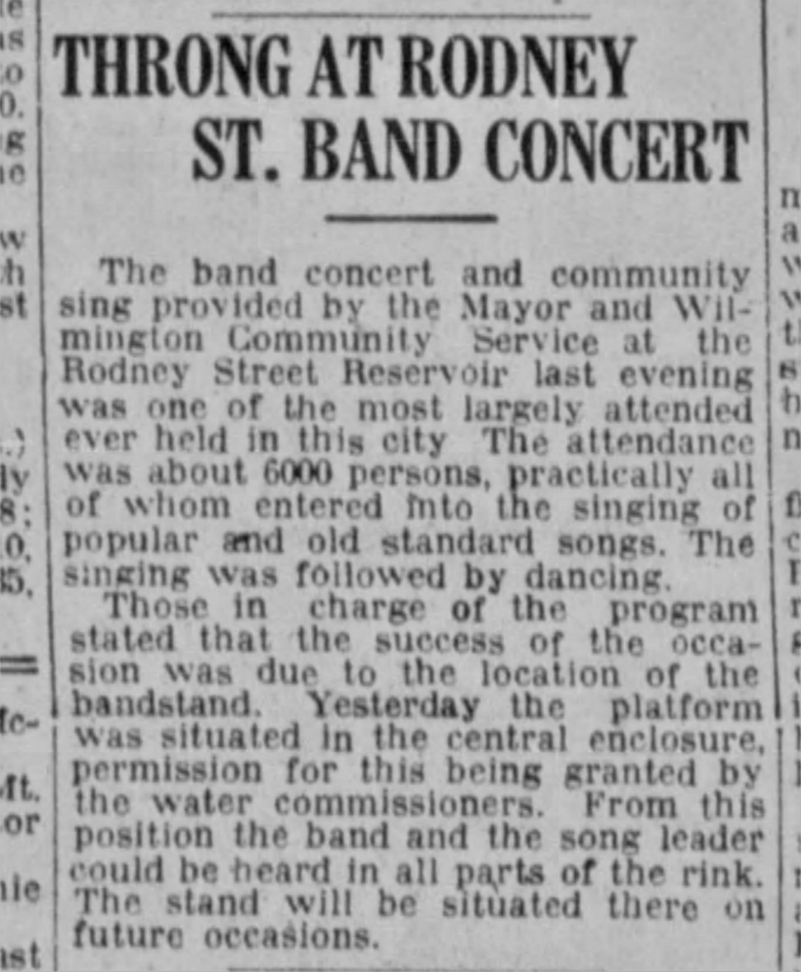
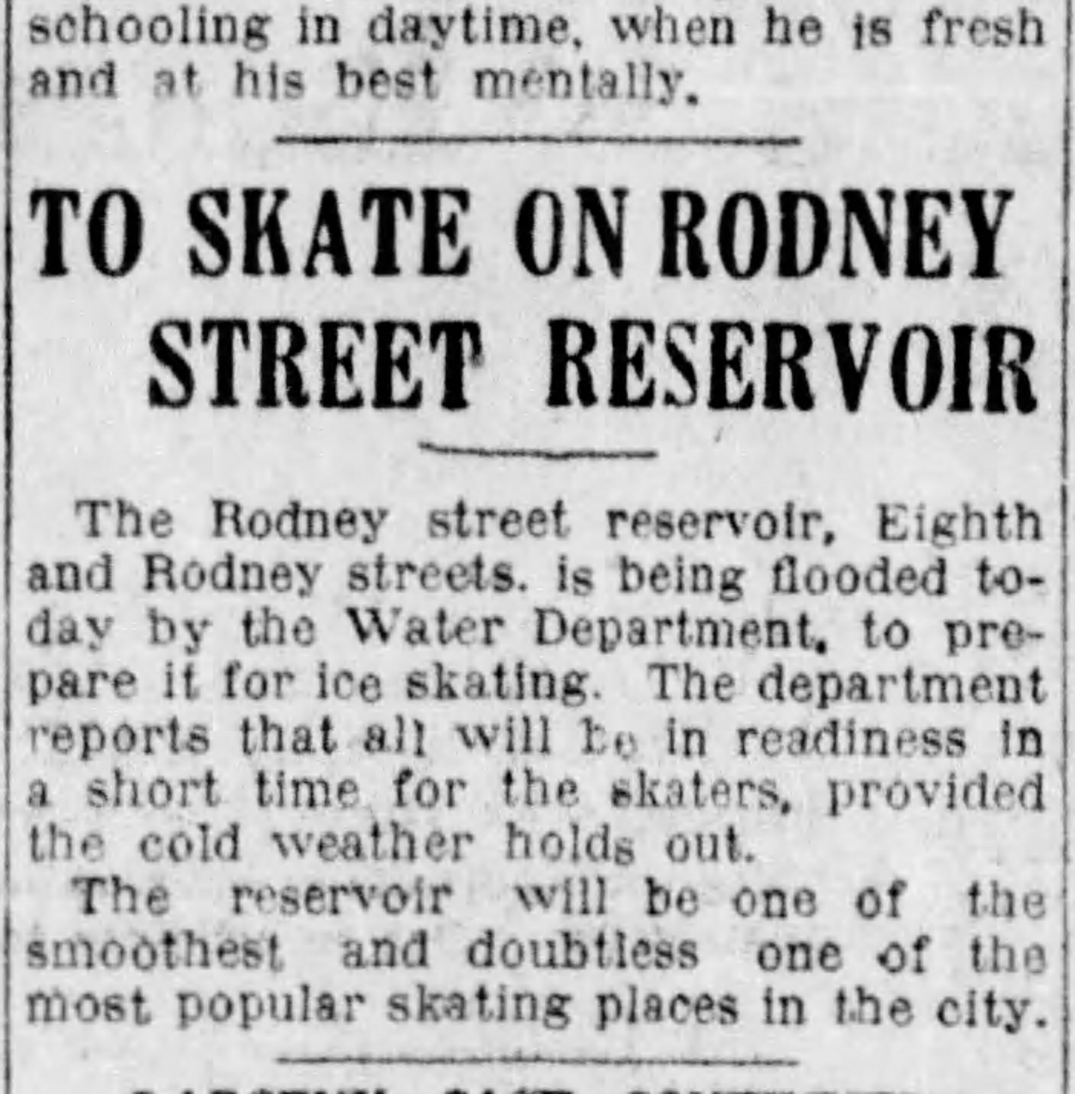
Rodney Reservoir: 150+ Years of Public Use
The skating rink and a shelter were included in original specifications for the 1916 Rodney Reservoir project.
The August 1922 event was one in a series of popular concerts, sings and dances hosted at the site.
Tower opened in 1919 boasting a view of four states!

Slide 7
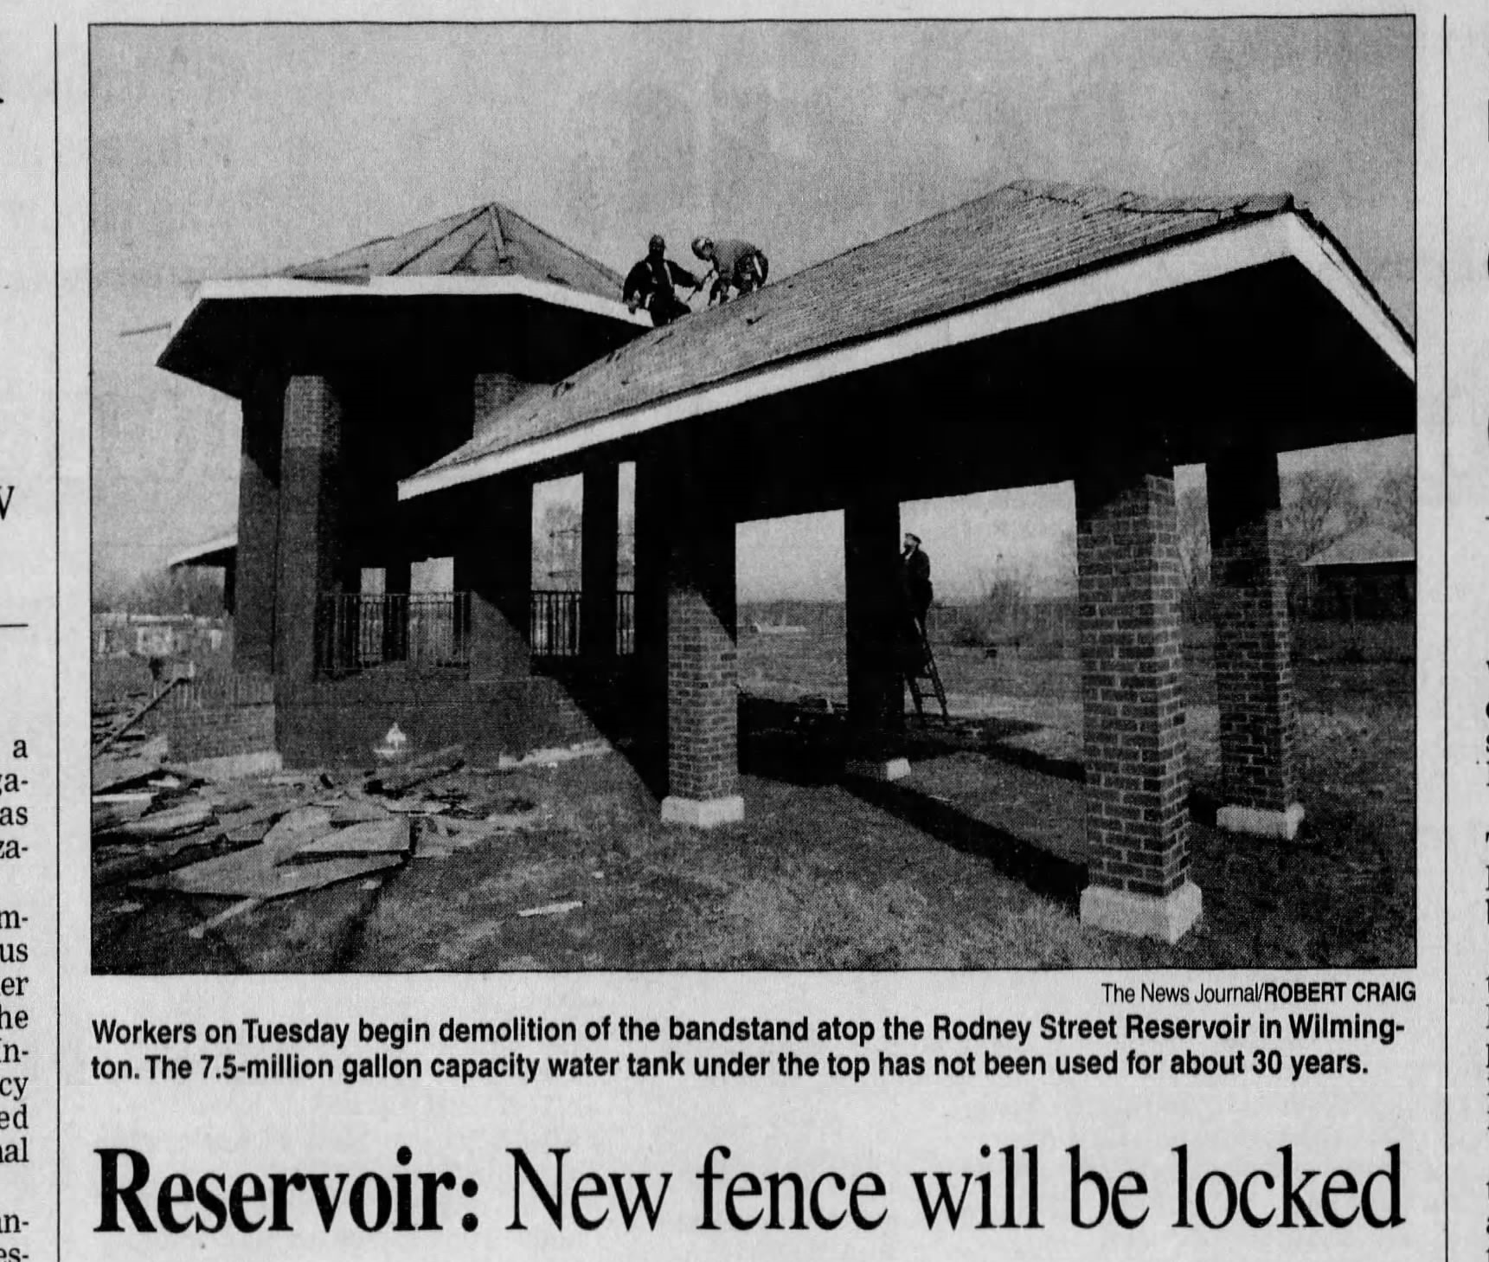
From the 1980’s to 2004
In the 1980’s and 90’s the site hosted basketball courts and a gazebo.
In 2003/2004, the site was fenced with the stated reason of safety concerns.
The City announced plans to improve the site and open it for public events. This never happened.

Slide 8
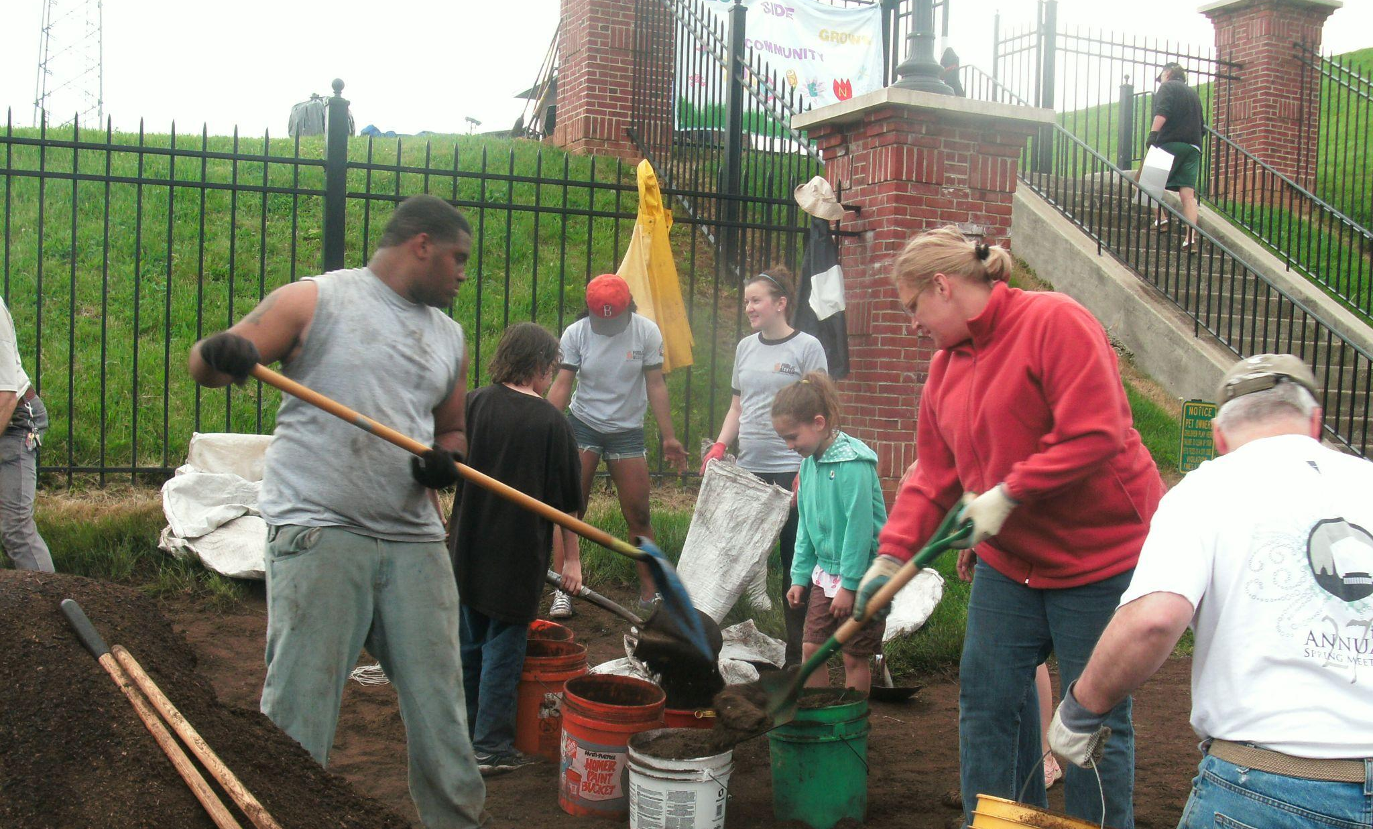
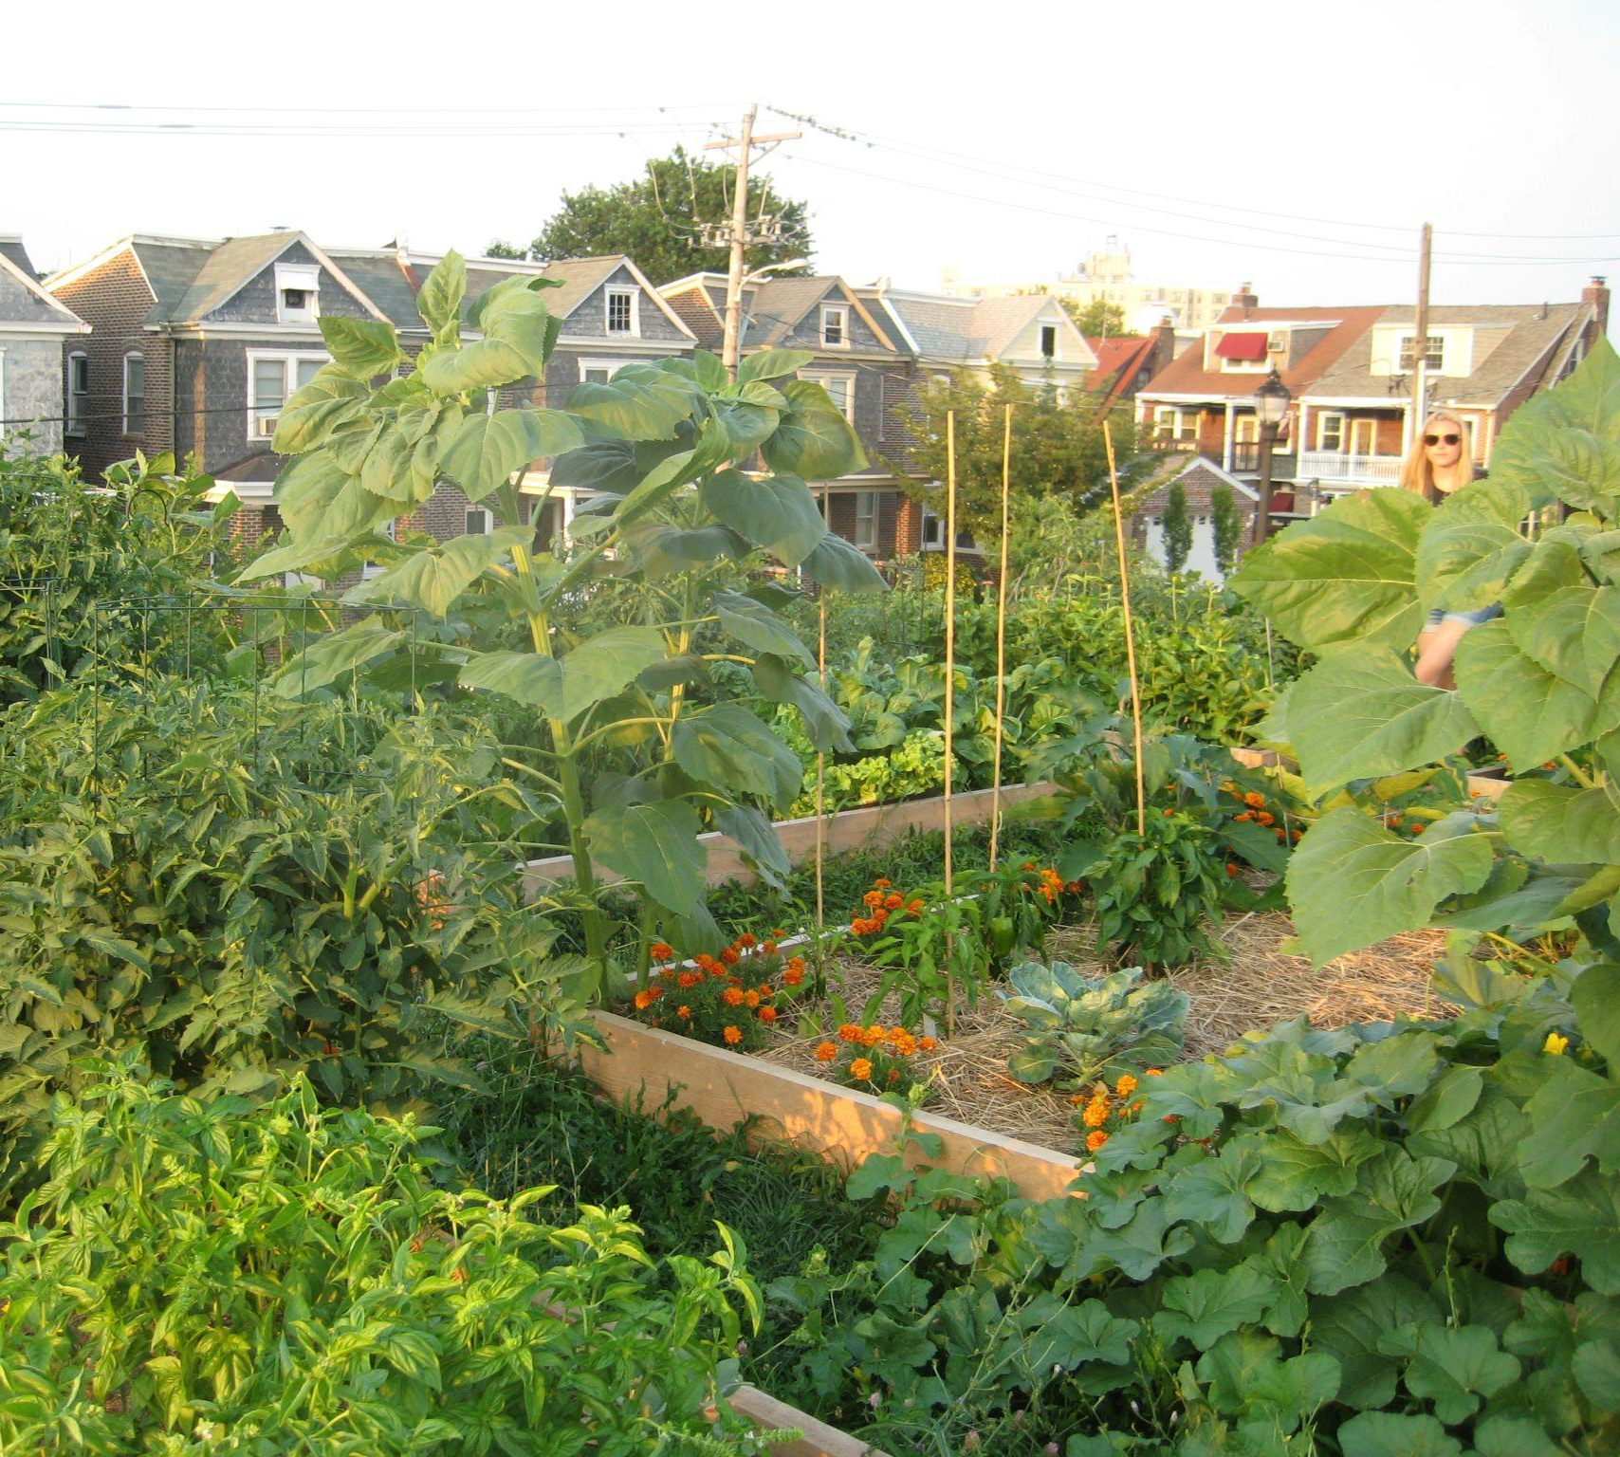
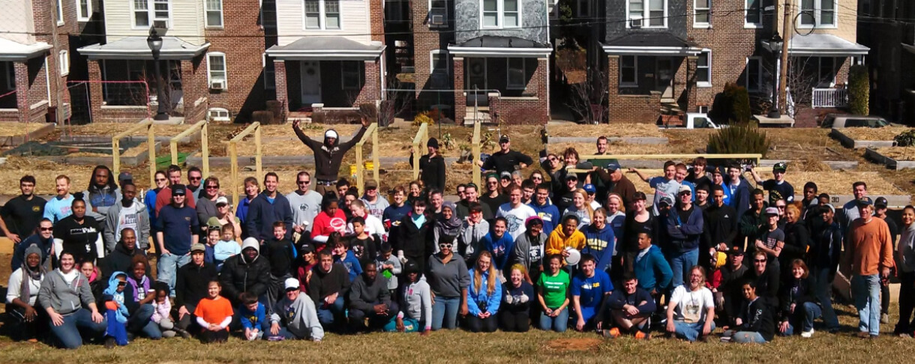
Rodney Reservoir
Community Garden
2010- present

Slide 9
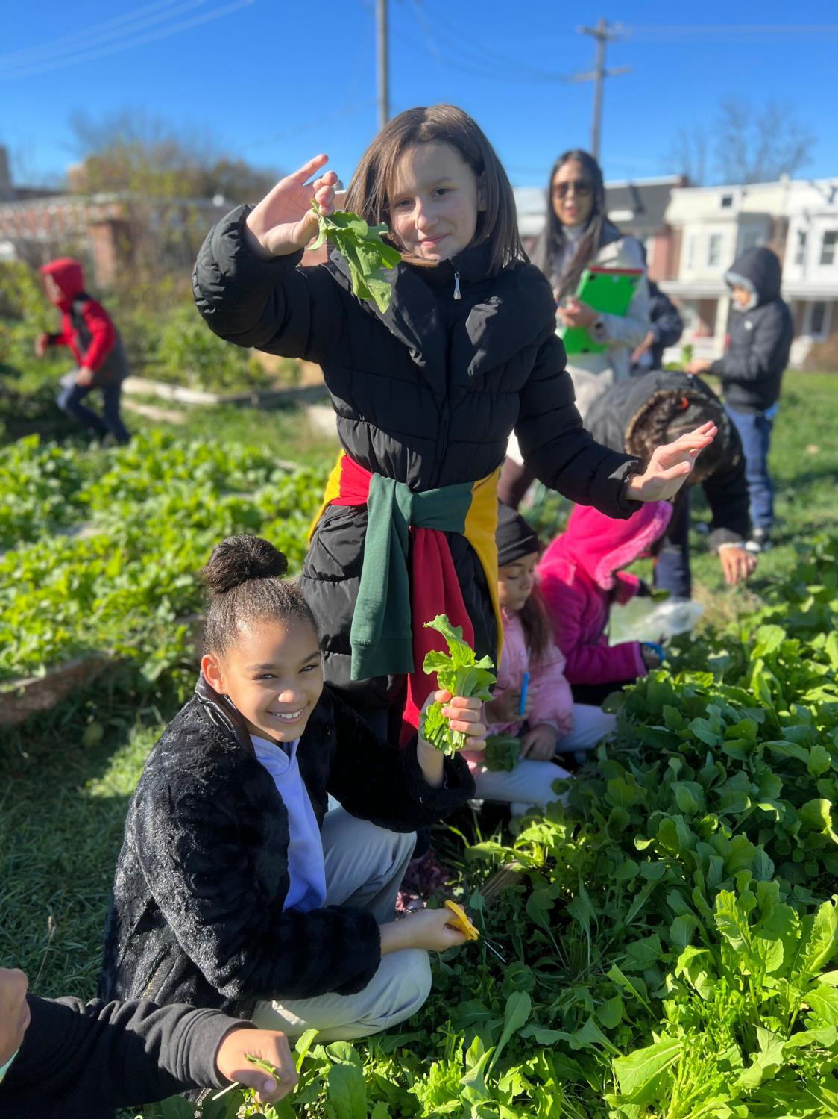
Outdoor Education
Partnership with Healthy Foods for Healthy Kids and Lewis Dual Language Elementary.
Teachers and Students grades K-5 began gardening in the Community Garden.
They are learning about science and where food comes from.

Slide 10
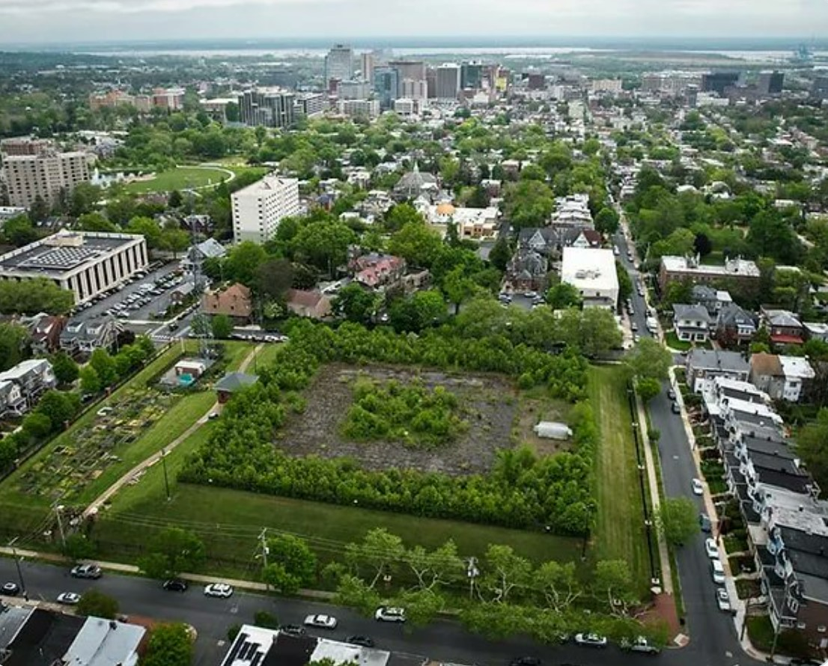

Slide 11
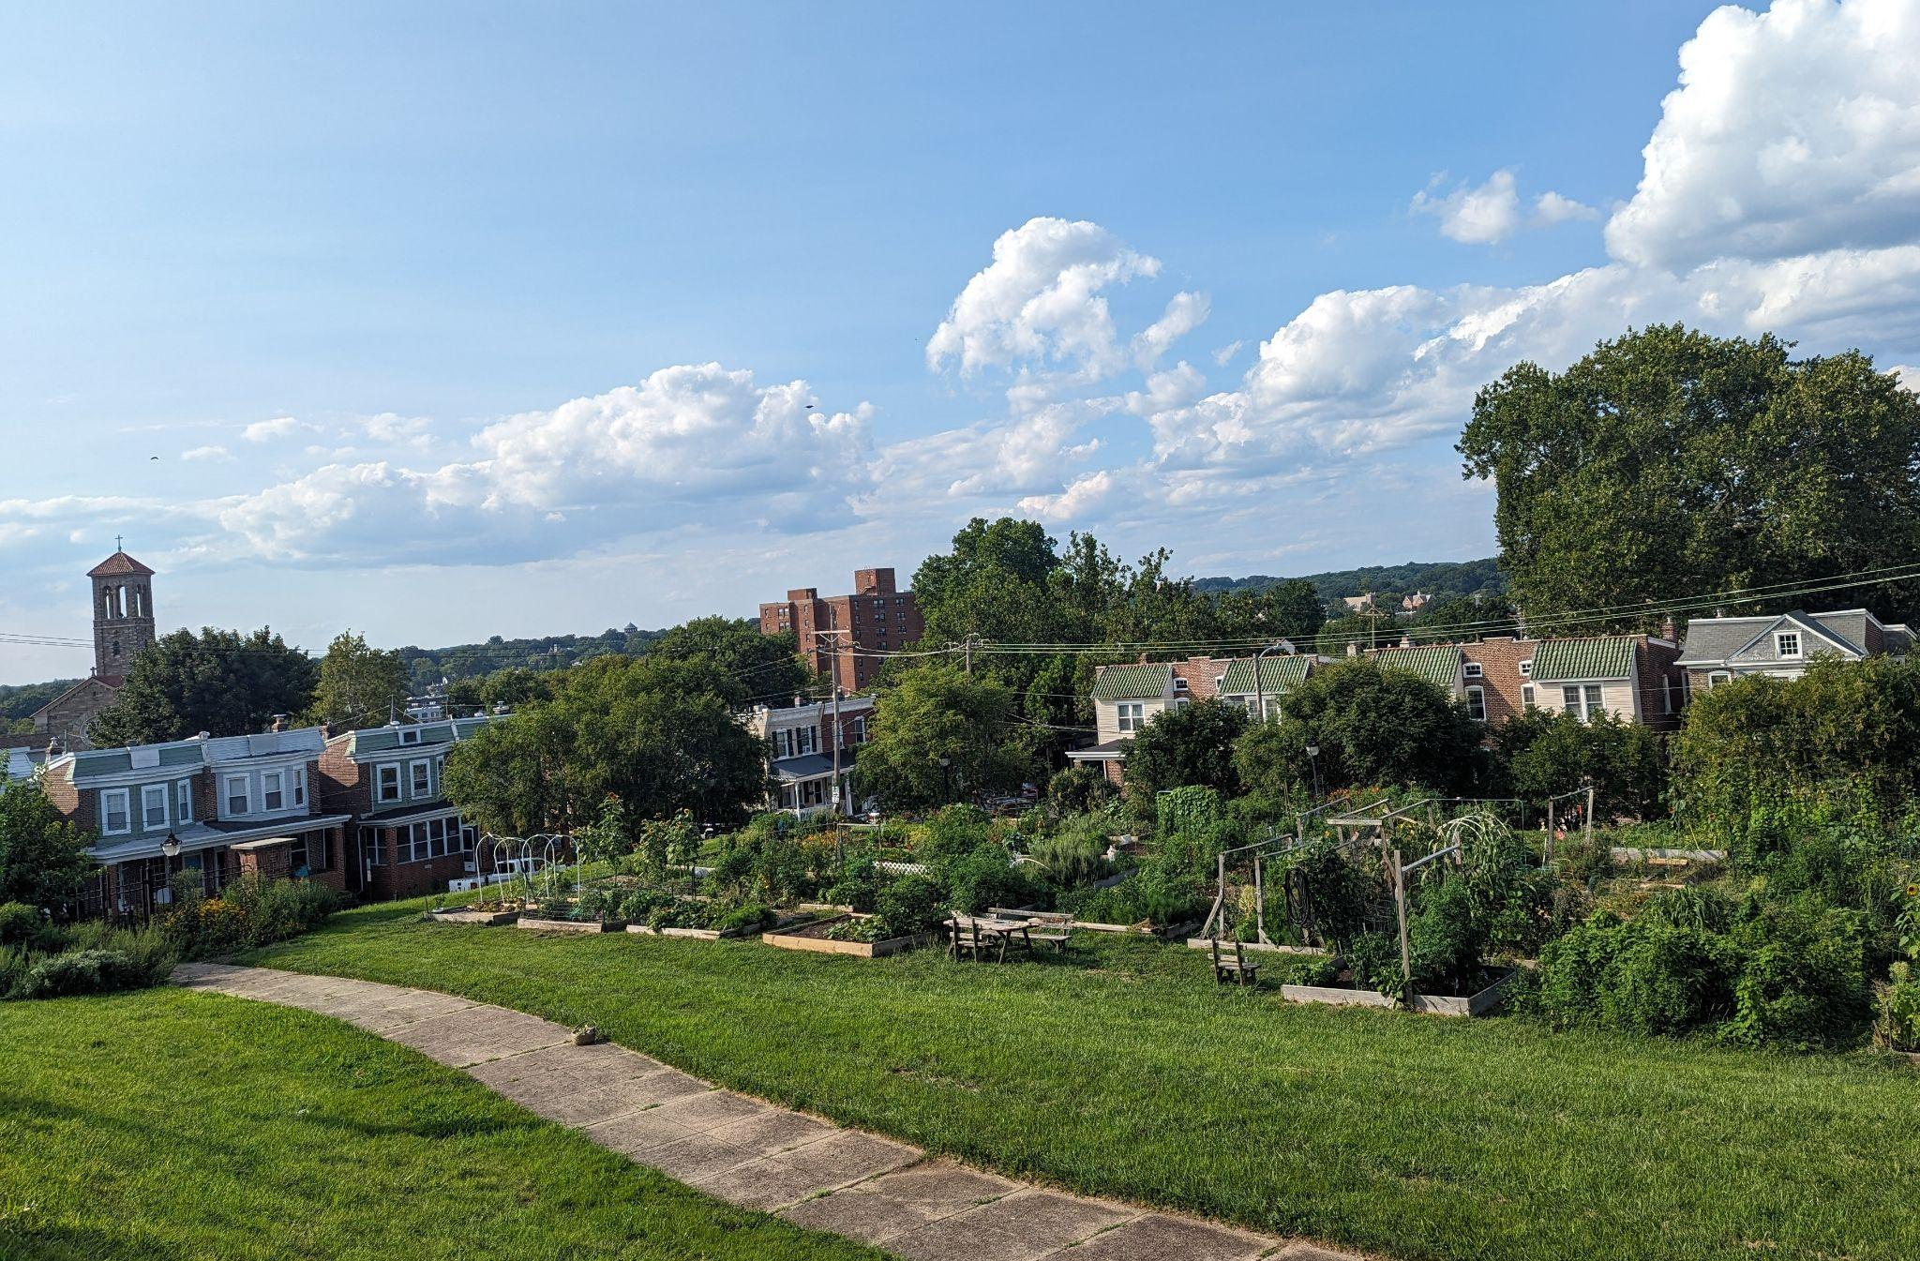

Slide 12
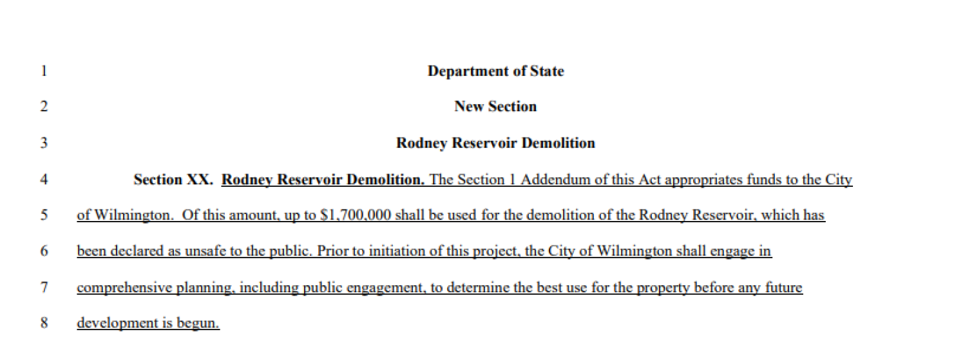

Slide 13
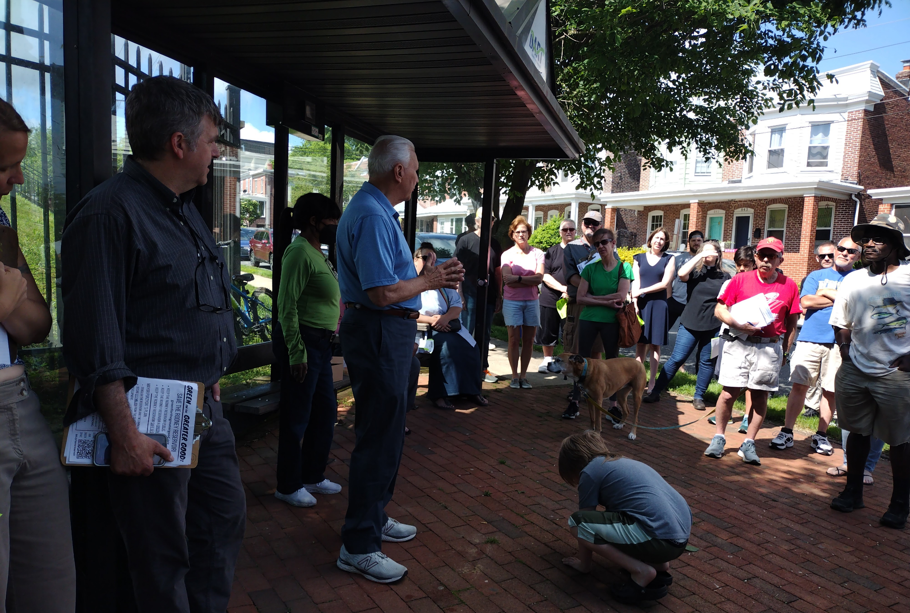

Slide 14
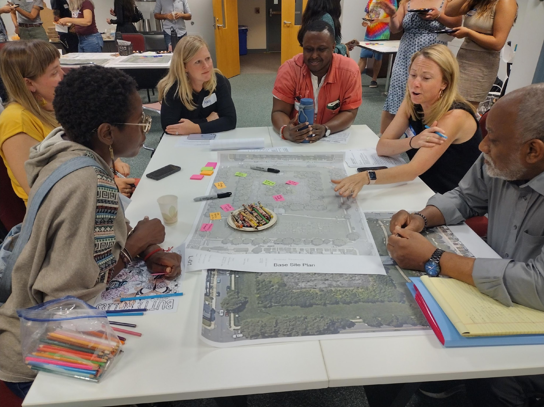
Rodney Reservoir Community Design Charrette
A charrette is a multi-session collaborative design process.
The goal of the charrette was to engage residents in imagining the Rodney Reservoir’s future.
Facilitated by the Living Lab Research Group at the University of Delaware’s Biden School of Public Policy and Administration.
This project was funded by a mini-grant from the Wilmington Partnership.

Slide 15
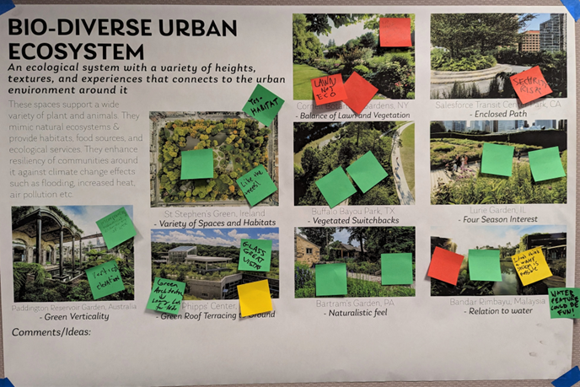
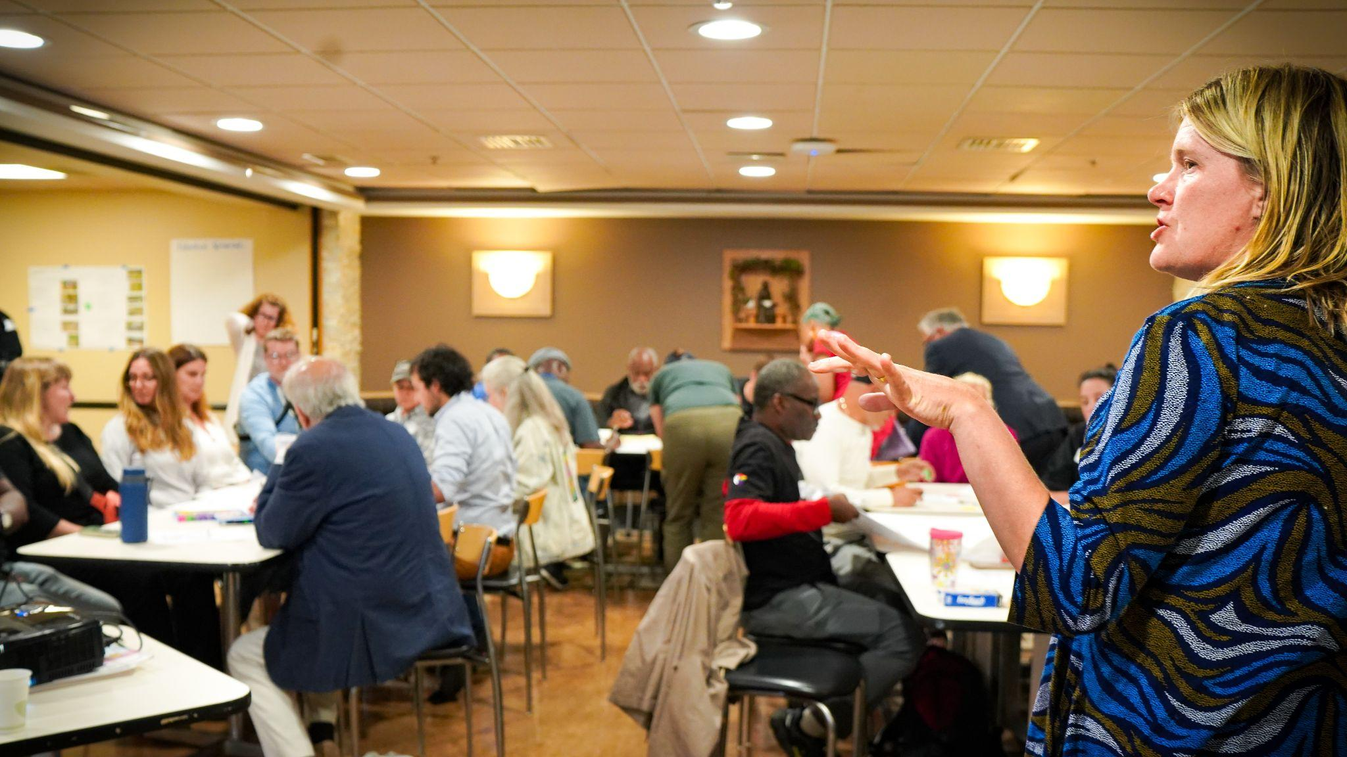
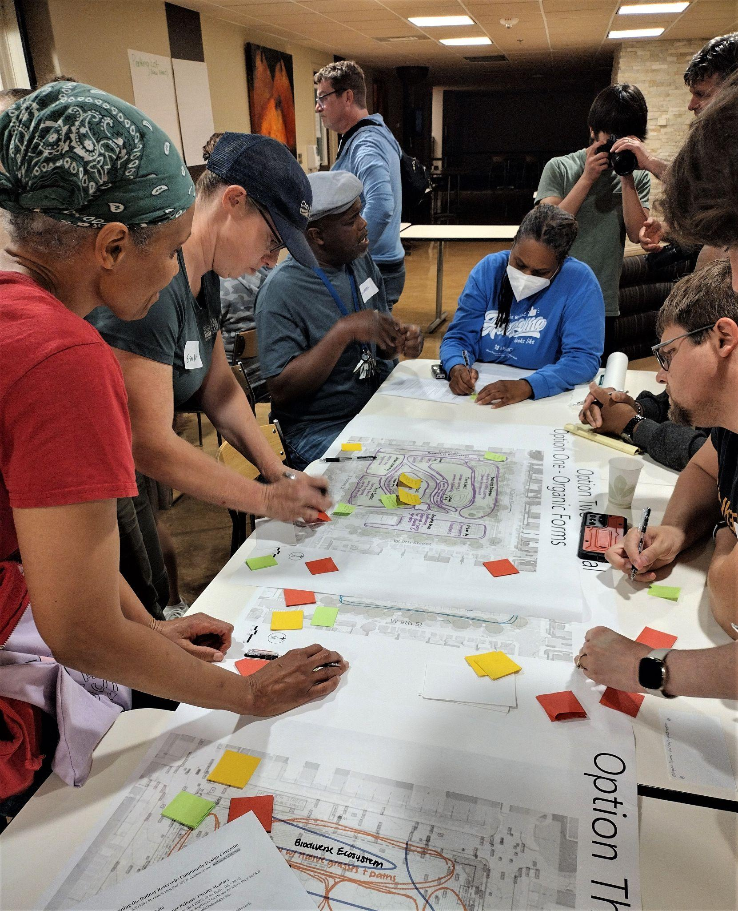
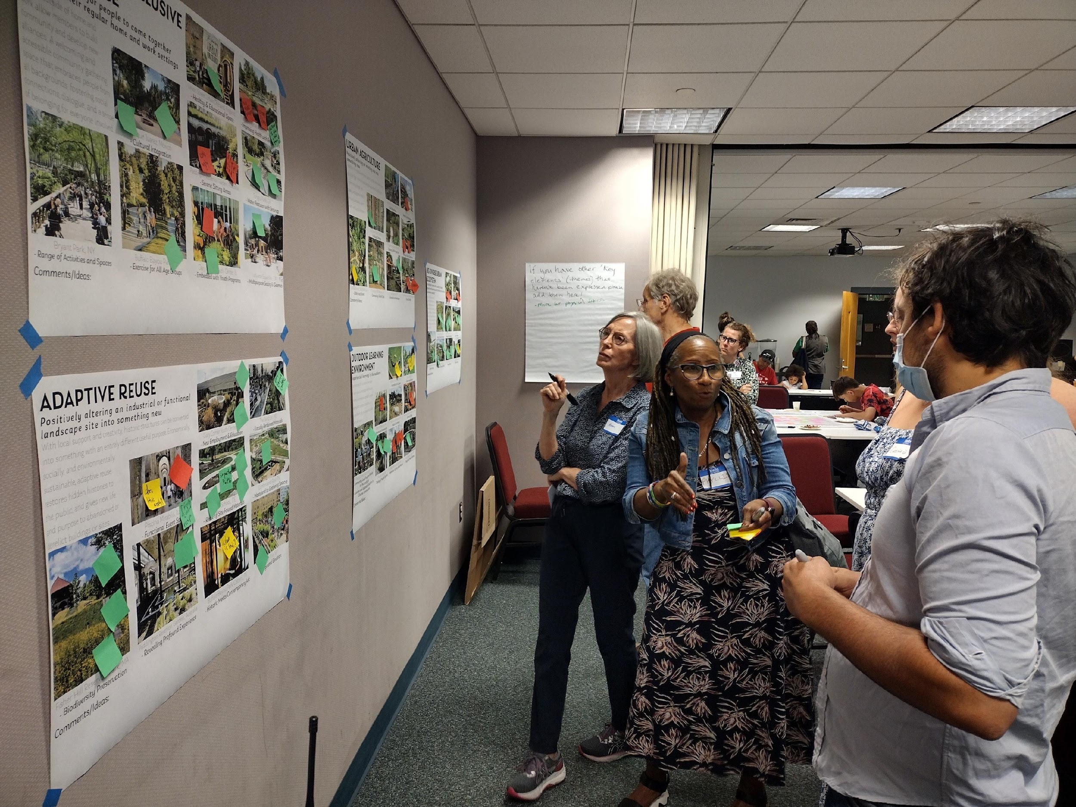
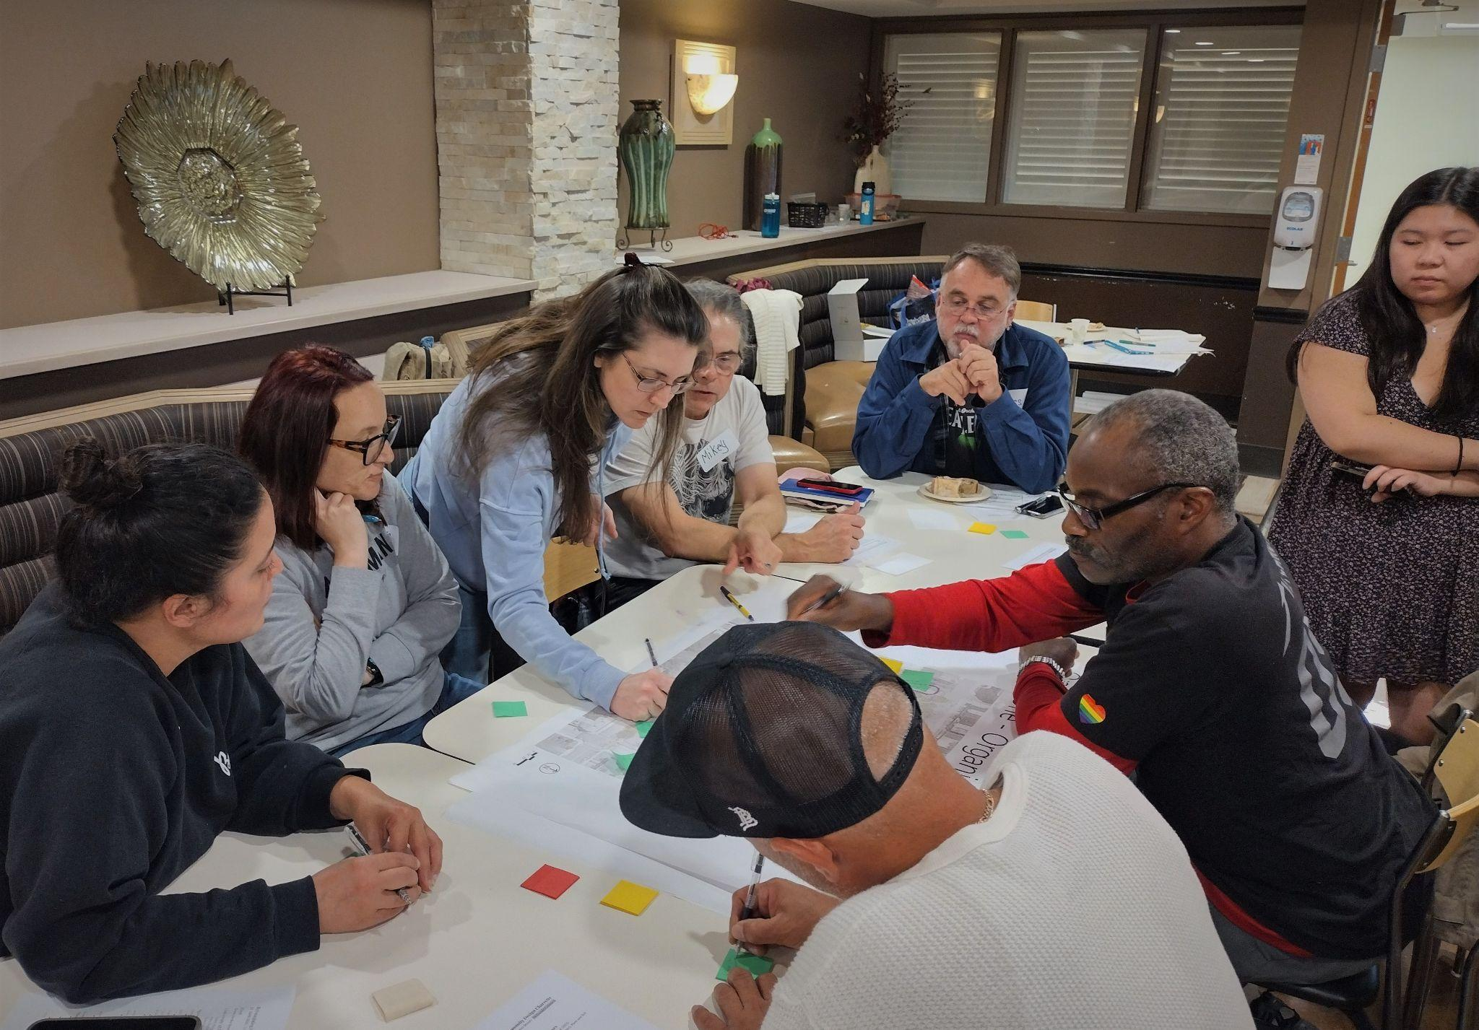
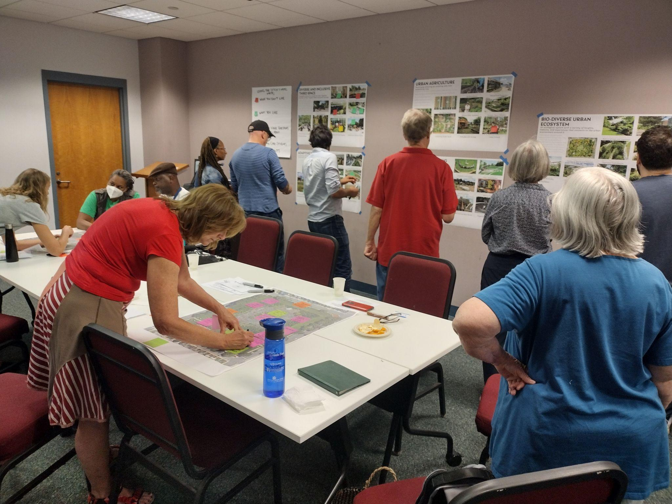
Community Design Charrette Highlights
Session I: Site Conditions and Concepts
Session II: Design Review and Feedback

Slide 16
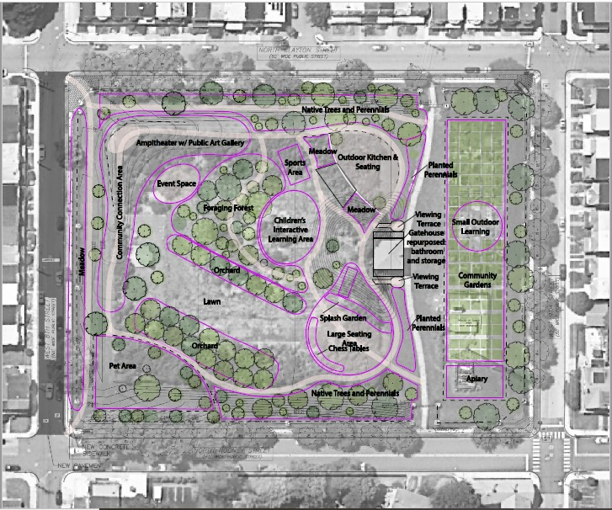
Community Design Charrette Session III
Preliminary Design Features
universal access
expanded community gardens
outdoor learning environment
demonstration site for sustainability
adaptive reuse
food forest (blueberry bushes, apple trees)
a pet area
public art
community gathering and event spaces
outdoor recreation areas
water features
walking trails
native plants

Slide 17
A Transformative Opportunity
Over 80 community members have already come together to create a high-level vision for a nature- and community-focused park at the Rodney Reservoir
centers the public good
supports resiliency
promotes environmental justice
meets goals of the City’s 2028 Comprehensive Plan and
aligns with Resilient Wilmington Report.

Slide 18
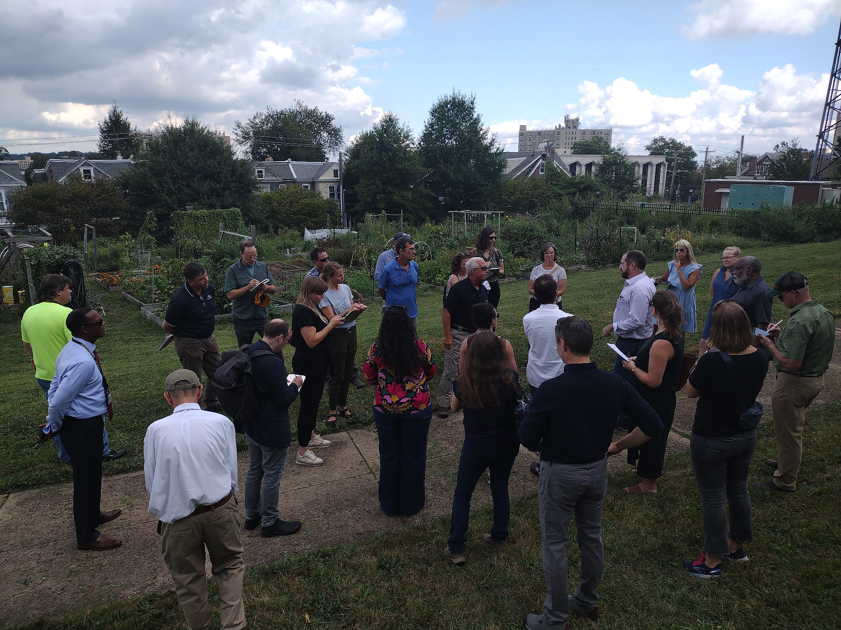
Rodney Reservoir Working Group
The City set up a Rodney Reservoir Working Group with City/Community participation to develop a design for the future Rodney Reservoir Park
Commitment to build on vision for a nature- and community- focused park from the Community Design Charrette.
Recently engaged a landscape architect firm to lead a community design process for the project.

Slide 19
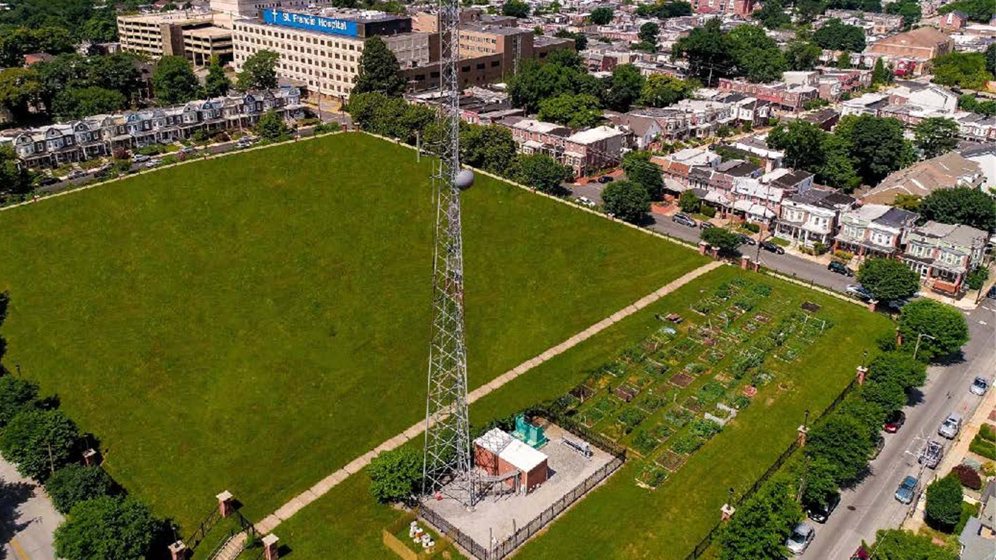
City Plans to Demolish Reservoir starting in Jan. 2024

Slide 20
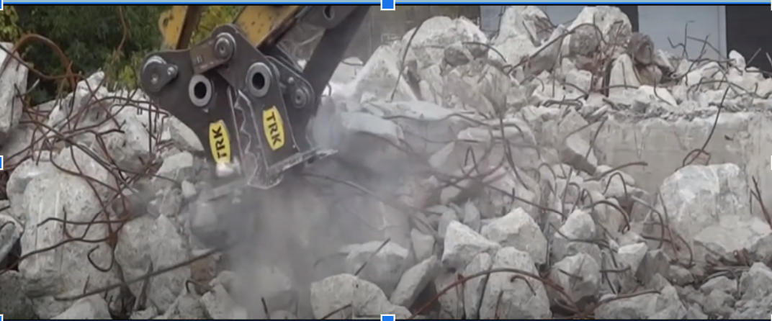
The City’s Demolition Plan
4 Months of Demolition
Break-up Concrete Water Tank
Run Concrete Through “Munchers”
Bury Rubble On-Site
Grade the Site
Plant Grass on Top

Slide 21
Hazardous Substances Onsite
Site Specifications indicate the presence of lead and coal ash at the site.
The City’s most recent soil testing report indicates the presence of:
Regulated substances in shallow soil are present at an unacceptable cancer risk under the resident scenario;
Regulated substances in combined shallow and deep soil are present at an acceptable cancer risk under the resident scenario;
Regulated substances in shallow and combined shallow and deep soil are present at an unacceptable non-cancer risk under the resident child HI scenario; and
Regulated substances in shallow and combined shallow and deep soil are present at an acceptable cancer and non-cancer risk under the urban garden, outdoor worker, excavator, recreator, and trespasser scenarios. (Verdantas October 10 report, p. 7)

Slide 22
OUR ASK: Prioritize Our Community’s Health
Protect Community from Exposure to Hazardous Substances
Develop a site-specific Contaminated Materials Management Plan that includes specific steps for identifying and addressing lead, coal ash, and other hazardous substances present at the Rodney Reservoir before starting demolition.
Enter into a settlement agreement with DNREC-RS for the Rodney Reservoir to proceed through the HSCA process to receive a COCR under the Voluntary Cleanup Program or Brownfields Development Program.
Approach Site Work Strategically
Use design strategies to limit soil disturbance and exposure.

Slide 23
Complete Design Before Starting Demolition
Complete a comprehensive planning process as required by the Bond Bill.
Build on the vision of the Rodney Reservoir Community Design Charrette to create a nature- and community- focused park.
Integrate design and construction phases in order to
Build on historic features of the site, including elevation/grade change
Save money
Reduce the carbon footprint of the project and tell the story of sustainable development
Center the community’s health and minimize risks related to the release of hazardous substances
Finish the design process and identify funding for construction before starting demolition.
Build an AWESOME park for all to enjoy that will improve our environment.

Slide 24
www.greenforthegreatergood.org
Facebook and Instagram @GreenfortheGreaterGood

