Slide 1
Bureau of Property Maintenance and Housing Inspections Department of Community Planning and Economic Development
Notes:
Good evening, I am James Nixon, Bureau Chief Property Maintenance & Housing Inspections
Tonight, I will provide details and highlights of How Chapter 238 Rental property ordinance supports and protects the renter in the city of Lancaster!
I will provide key updates to this ordinance, The new way of enforcement the Bureau has taken on, how we are moving more efficiently, as well as our community engagement actions.

Slide 2
How does Tolemi affect the public
Provides up to date information to partners and residents of the city
Holds landlords accountable
Creates transparency of the work we conduct within the Bureau
Notes:
HOW DOES THIS ORDINANCE SERVICE THE PUBLIC
The City of Lancaster’s residential rental property licensing program provides an efficient system for compelling both absentee and local landlords to maintain 13,486 residential rental units to current code standards.
We hold landlords accountable to these standards.
In 2022 the Bureau inspected 4,638 units. Our inspections in the last year have produced 8,657 violations that ensure that the city’s residents are protected and provided safe and quality housing.
this ordinance Provides jurisdiction to protect households from Lead Hazards. This ordinance grants the ability to ensure that the approximately 12,000 rental properties built prior to 1978 will be inspected for possible lead hazards during the systematic inspection process to minimize LEAD HAZARDS within our housing stock
An average of 3 violations per property.
313 Parcels inspected without violations

Slide 3
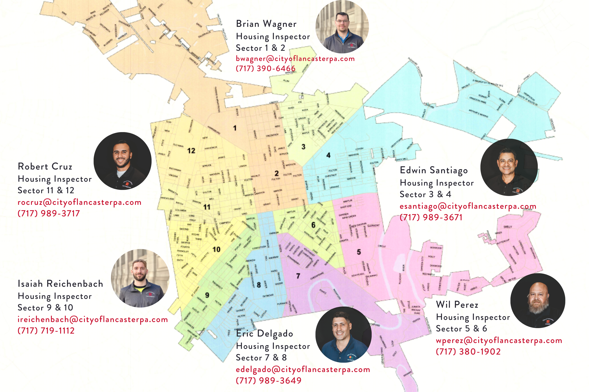
New way of enforcement
Educate landlord and property owners
Engage the community
Provide public educational materials
Ensuring safe and quality housing stock through the administration of the City of Lancaster’s Property Maintenance and Rental Property Ordinances.
Notes:
The Bureau of property maintenance and housing inspections are committed to educating landlords and Property owners as well as engaging the community to better the housing stock. We recognize the importance of community and have created postcards like you see on this slide that introduces each sectors Housing inspector, so our residents can recognize who we are and that we are here to service their housing needs.
We will provide Property Owners and landlords with;
Rental License guide to be/provided at time of license application and renewal).
Rental Property Checklist to be Provided prior to systematic inspection).
Intro to compliance Notice to Provided to owners when properties are in non-compliance to Rental ordinance).
We are committed to Engage the community
With Participation in public events such as Mayor's Neighborhood Month for the first time
Provide postcards reflected in this slide that details WHO, HOW & WHY to the community
We look to be intentional in our approach to serve the residents of the city of Lancaster and to ensure a quality housing stock is being provided.

Slide 4
Moving more efficiently
Improve consistency across inspectors
Inspection checklist
Collaborative culture
Notes:
The Bureau has created an inspection checklist. Which will improve the consistency of our inspections this is an internal checklist reference tool for staff to use during their inspection to ensure efficiency and best practices are met.
We will Provide landlords rental property checklist guides to help in preparation of their systematic inspections. This guide is for landlords & property owners to be aware of items that will be evaluated at the time of inspection. This document summarizes major items covered in a rental inspection.
Our Inspectors have been involved in designing SOPs and this ordinance as well best practice sharing at monthly meetings.
Tolemi helped to smooth out the inspection schedule that allows for my team of 8 inspectors to inspect all 16k rental units within a four-year time frame. We are currently on track to complete this task in 38 months.

Slide 5
Community Engagement
Block walks
Participate in neighborhood organizations
Distribute education materials
Meet with landlords and property owners
Notes:
Our bureau has made strides in connecting with the community through neighborhood groups, partnering with the Department of Neighborhood engage to cohesively develop ways to better improve the quality housing standards in our communities.
We have a scheduled meeting with landlords of different neighborhoods to discuss how we can support and provide education to landlords in their role and responsibilities to ensure a positive quality of life for our city residents.
Along with the Department of neighborhood engagement we have partnered with community groups and community stakeholders to conduct community walks to engage our residents where they live.
Yearly we will schedule community block walks to engage residents and to ensure quality housing standards are being met.
Earlier this summer we conducted the Beaver Street community walk and saw success by engaging residents and helping to meet social needs, housing needs and cultural needs. Thanks to our community partners from SoWe, Church world services, The cities Lead Team.
As a result of their efforts towards canvassing Beaver Street, a property has been approved for a new roof replacement and a new replacement of their heating and cooling system through the critical repair program. Both contracts together resulted in $14,895 being spent saving this house from any further damage

Slide 6
Conclusion and Questions
Notes:
In closing I would like to thank the individuals of the Bureau of Property Maintenance & housing inspections for their commitment to serve the Residents of the city of Lancaster. Our team is committed to a new way of enforcement that provides community engagement and are committed to serving our community more efficiently!
I would thank each City counsel member for there time and commitment to serve the city of Lancaster and I am open to answer and questions you may have for me.

