Slide 1


EDtv
Presented by
Red Clay Consolidated School District
November 7, 2023

Slide 2


EDtv - 24 hour educational programming.

Slide 3

Current Programming
SciShow Kids
The BookNook
CNN Student News
The GoodStuff
Red Clay Cook-Off
Project SoapBox
Education Station

Slide 4
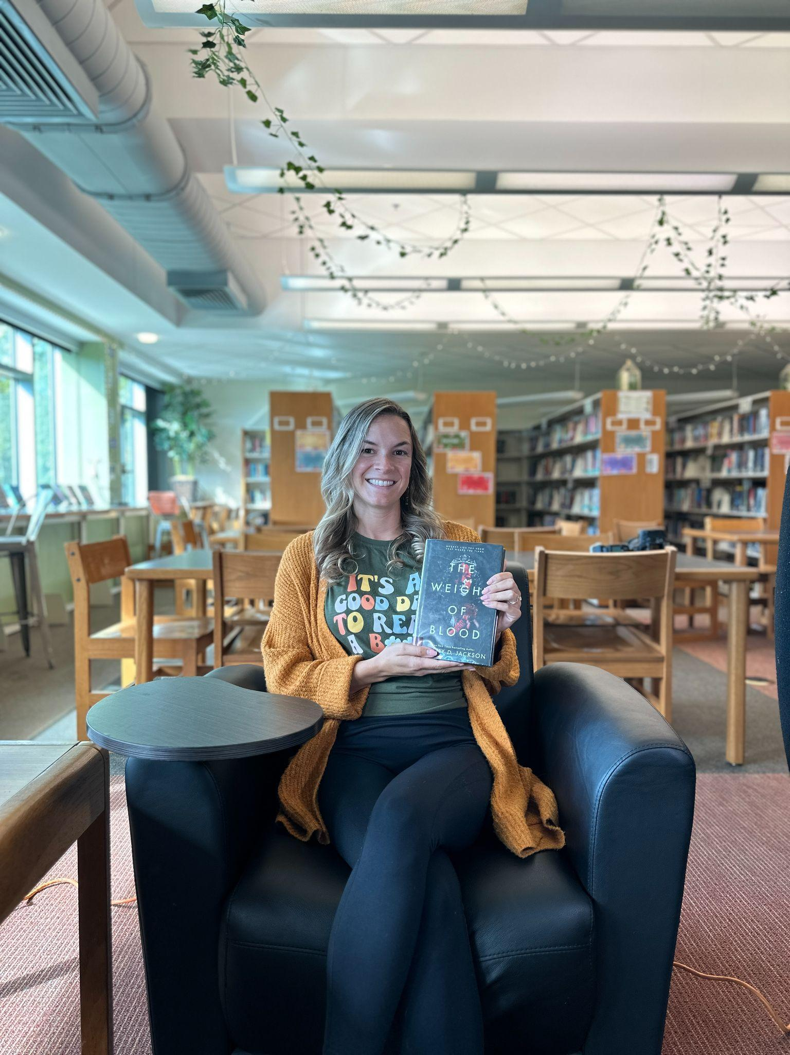
EDtv Original Shorts
eSports
The Arts of Education: Valuable Life Skills Through Dance (Ballet)
A Beautiful Tomorrow
Hero Days in Red Clay
Mivka Challenge
Red Clay Block Party
Student Leadership Summit
Hispanic Heritage Month Celebrations
Paws4People
Don’t Rush the Red

Slide 5


Community Slides

Slide 6

Future Agenda
Red Clay is always open to airing educational content from other districts and community programs
  Colonial School District’s monthly video currently airs
  We have often contacted other districts
Content and clips of full programs are posted to social media to promote the channel
Currently working on a unnamed Speaker series
Content is being shared on YouTube to further promote the channel

Slide 7
Contact Us
Alva P. Mobley, MBA | Chief Communications Officer
alveretta.mobley@redclay.k12.de.us
Horace Knight |Communications Specialist
horace.knight@redclay.k12.de.us

Slide 8






#RemarkableRedClay
@redclayschools.com

