Slide 1
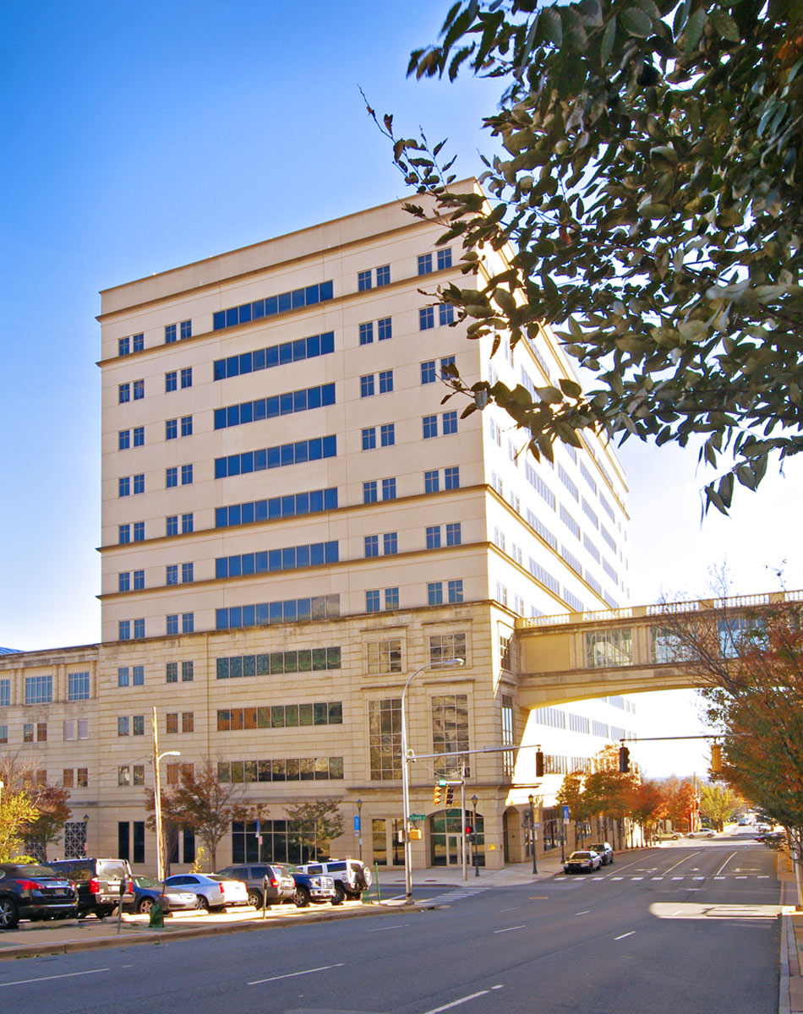
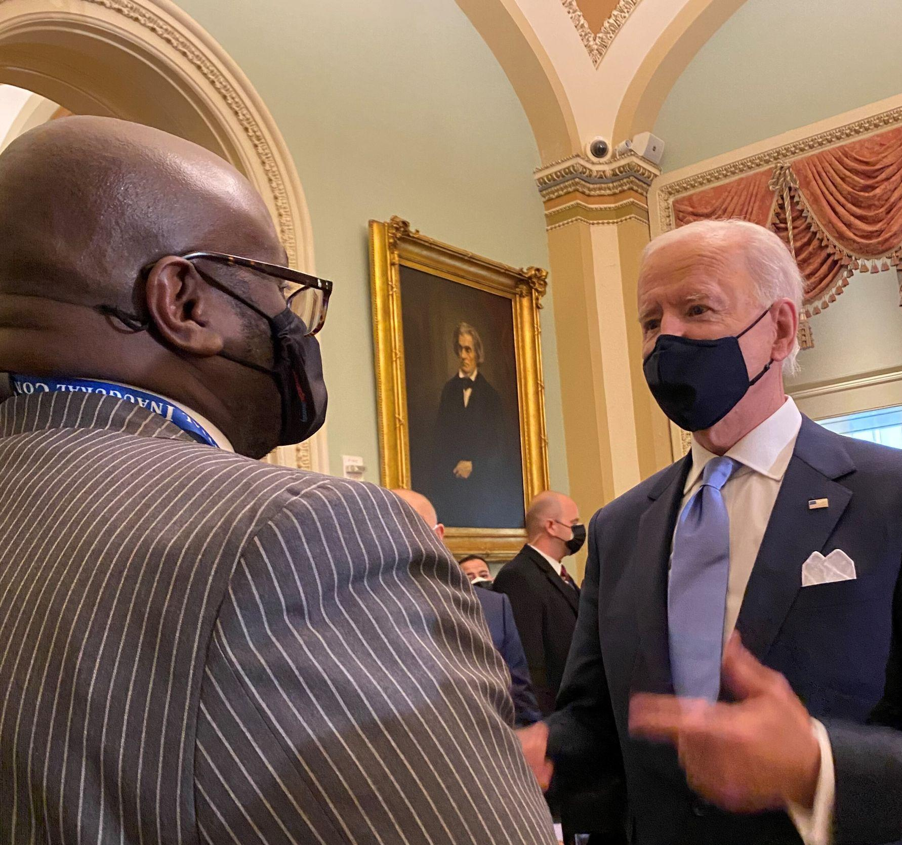
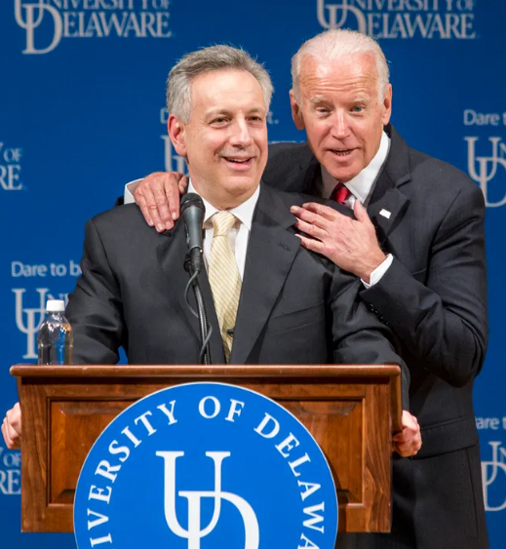






Catalyzing Wilmington’s Revival
October 7, 2024
1

Slide 2
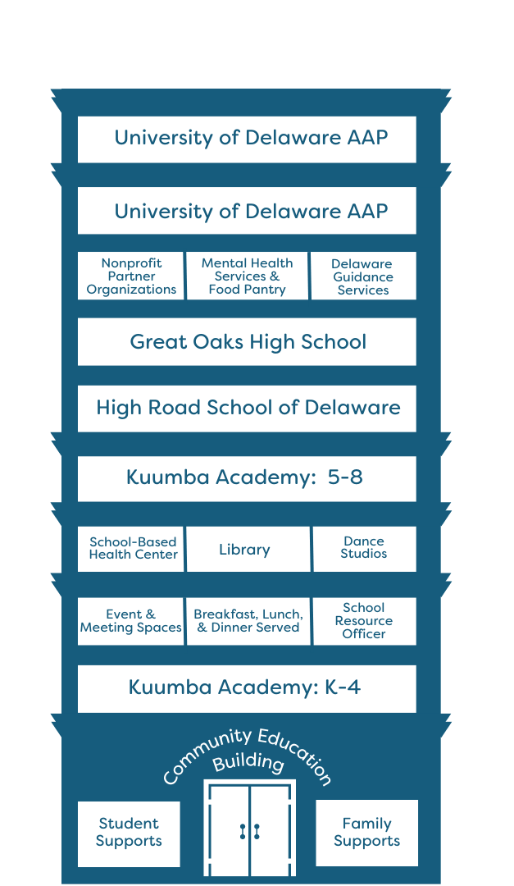
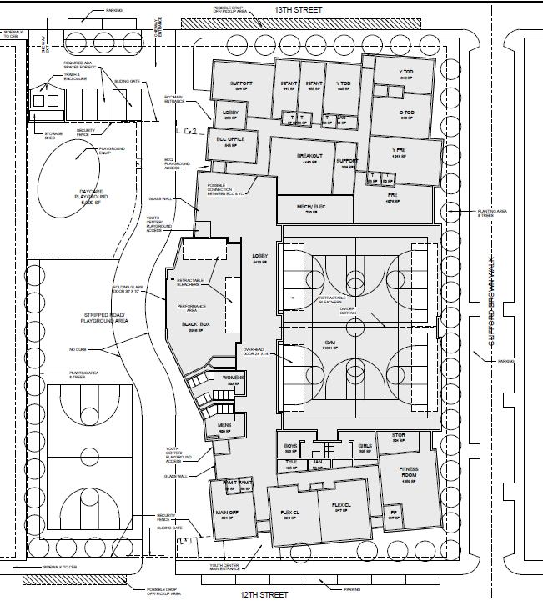
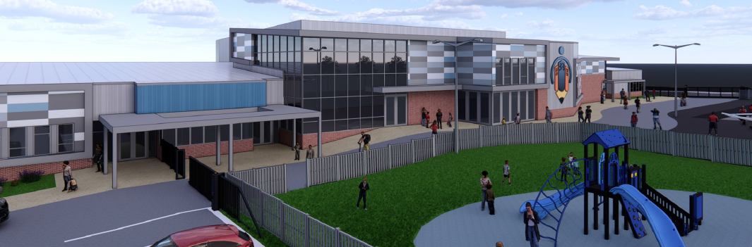
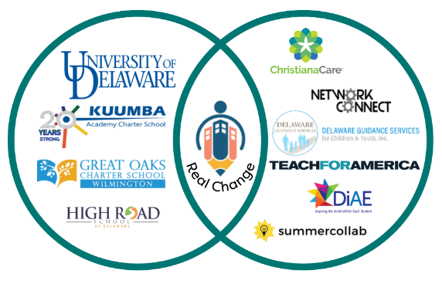

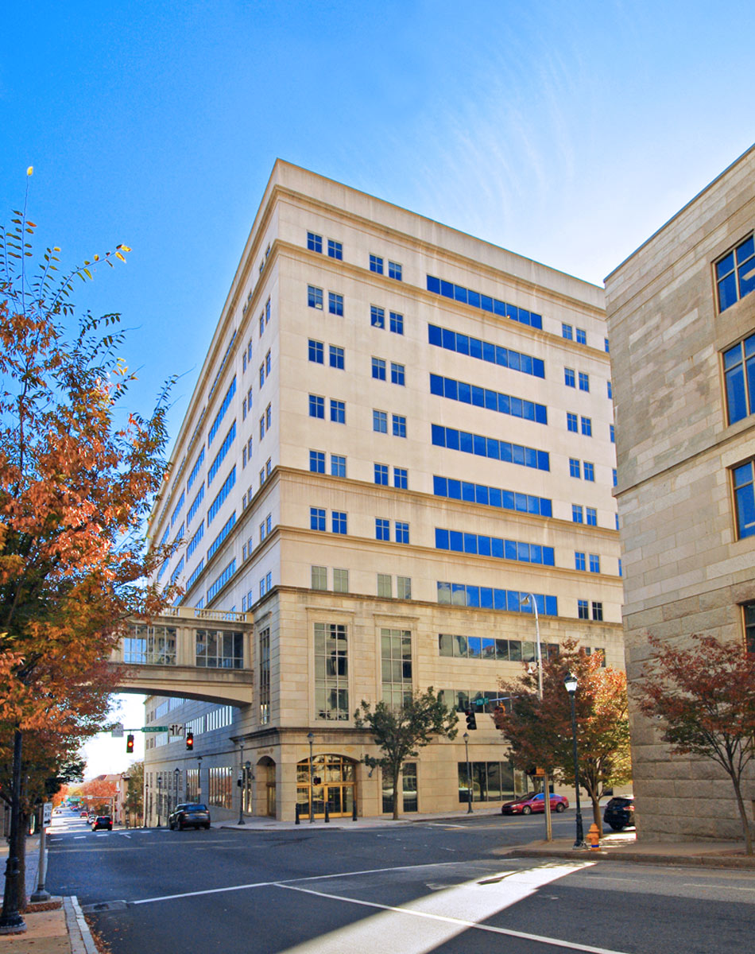
The CEB / Bridge offers significant community ROI
$189MM in total investment, >3500 students, >400 jobs, $10MM total investment requested from the City
CEB—$110MM in private investment
Collaborative education environment focused on Pre-K to Secondary
  Delivering wrap-around education and family support solutions that yield measurable results
  1,100 students, faculty and staff
  $0 investment from City of Wilmington
YDC—$19MM investment
Recreation, education and community health
  The education-health-violence reduction nexus
  7,800 expected students and community members serve annually; 60+ full- and part-time jobs
  $0 investment by City of Wilmington
—$60MM investment
  A new university environment focused on turning community challenges into social and economic opportunities
  Completes the cradle-2-career pipeline; university/graduate school opportunities for local community
  2,600+ expected students, faculty and staff
  $10MM requested investment from the City of Wilmington
2

Slide 3

Targeted Participants
Together, the participating members of will account for 2,000 students, faculty and staff—requiring services and housing, driving demand for downtown real estate. It will fill a 240,000 sq ft office building to be donated by Bank of America.
3

Slide 4
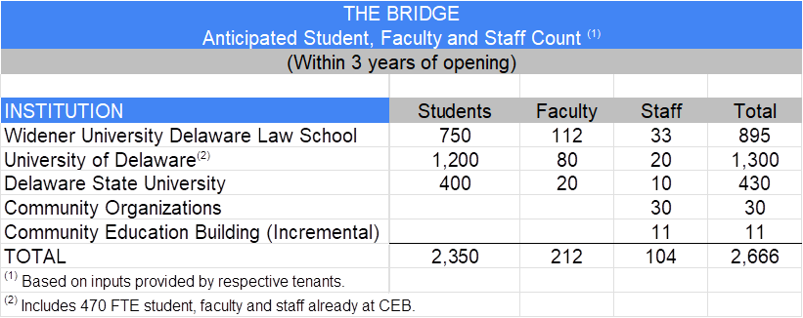
Estimated Occupancy at the Bridge
4

Slide 5
Sources and Uses
With $10 mm already allocated in the Bond Bill, an incremental $13 mm needs to be funded
October 7, 2024
5

Slide 6
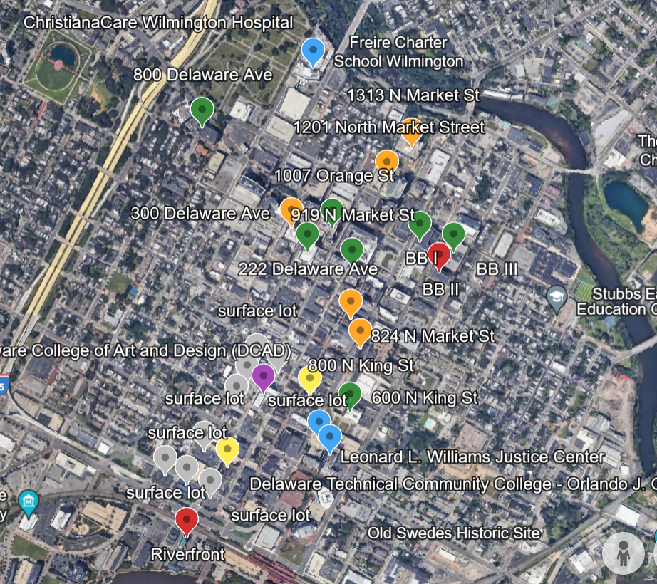
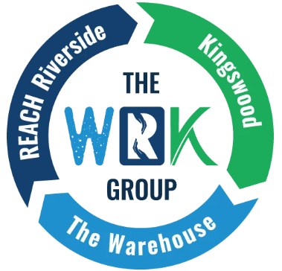
Long Term Place-Based Strategy
Wilmington’s “Campus Corridor” (blue box) connects Bracebridge II
to Riverfront Center
Contains 80% of the available office space in downtown Wilmington
Offers high-rise residential near the commercial center; potential opportunities for new residential development; many residential offerings around the perimeter
Intentional strategy to connect and create synergies between programming at The Bridge, Riverfront, Del Tech, and the WRK Group and circulate students; connect education activities to existing commercial, public impact (funding), and entrepreneurial activities
Connected Leadership Success Team including education, public services (in blue—courts, hospitals, etc.), nonprofits, property owners, and downtown businesses (law, medical, business, retail, restaurant)
Driving development of new jobs, businesses and organizations to address the challenges of Wilmington, creating demand for available real estate, developing scalable models for replication elsewhere
Newly formed partnership with the WRK Group
6

Slide 7
Projected Investment and Development
Projected 20-Yr Investment In Wilmington (in millions)
Source | Total
Bank of America | $20
Longwood (CEB and Bridge) | $110
Government | $100
National Philanthropies | $100
Private Developers/Corporations | $100
Induced Other | $90
20-Year Total | $520
Projected 20-Year Development Downtown Wilmington (in millions)
Project | Total
CEB | $110
Youth Development Center | $20
The Bridge--Bracebridge II | $60
Additional Education Facilities | $100
Required Housing | $100
New Business Starts | $80
Facilities for other community orgs | $50
20-Year Total | $520
October 7, 2024
7

