Slide 1


Office of the
Marijuana Commissioner
.
October 23, 2024
Commissioner Rob Coupe
Community Development & Urban Planning Committee

Slide 2


Agenda
OMC last presented to Wilmington City Council Health, Aging & Disabilities Committee on May 22, 2024.
Timeline for Implementation and License Types
Application & Licensing Process
Considerations – Towns, Cities and the Gray Market

Slide 3
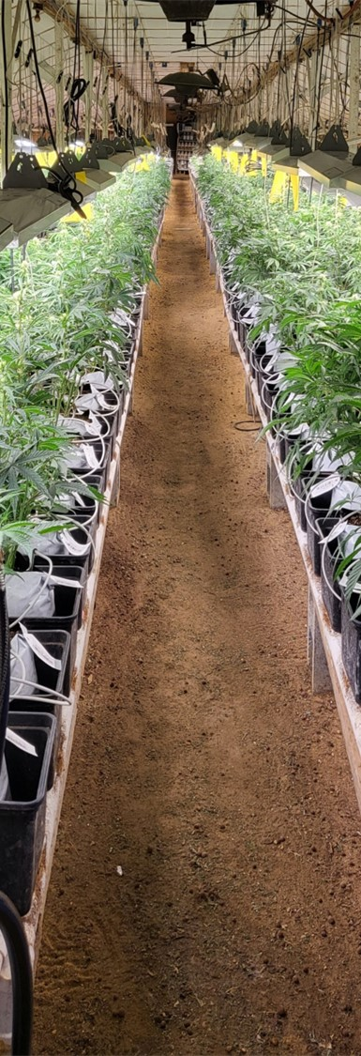

Timeline for Implementation
July Sept.11, 2024
Adopt regulations for licensing adult use recreational marijuana businesses
September 1, 2024
May begin accepting license applications
December 1, 2024
Shall begin to issue 30 Manufacturing Facility Conditional Licenses
March 1, 2025
Shall begin to issue 30 Retail Store Conditional Licenses
Final
Opened August 19th
Closed September 30th
Lottery October 24, 2024
March 1, 2025
Shall begin to issue 5 Testing Facility Conditional Licenses
November 1, 2024
Shall begin to issue 60 Cultivation Facility Conditional Licenses
Title 4 § 1343. Licensing Process

Slide 4
License Types - Total New Licenses – 125
Cultivation - 60
Open Cultivation License: 20
Social Equity Cultivation (≥2500 ft²): 10
Microbusiness Cultivation: 20
Social Equity Micro Cultivation (≤2500 ft²⁾: 10
Manufacturing - 30
Open Manufacturing: 10
Social Equity Manufacturing: 10
Microbusiness Manufacturing: 10
Retail - 30
Open Retail License: 15
Social Equity Retail License: 15
Testing Lab - 5
Open Testing Lab: 3
Social Equity Testing Lab: 2
includes 47 Social Equity Licenses
Notes:
Sect 1332 Retail marijuana store licenses
Sect 1333 Marijuana testing facility licenses
Sect 1334 Marijuana Cultivation facility licenses
Sect 1335 Marijuana product manufacturing licenses

Slide 5
Application & License Costs:
Non-refundable Application fee is $5,000
Discount: Social Equity application fee is $1,000 (§1337)
Discount: Microbusiness application fee $3,000 (§1341)
OMC license fee is $10,000 for two-year license (adjusted costs for Cultivation license based on plant grow canopy size cost $2,500, $7,500, or $10,000)
Social Equity and Microbusiness licenses are discounted to 40% of regular license and cost $4,000 for two-year license.
Sunday Sales require a $500 biennial license fee §1309 (b)(3).
(Note: T4 §1309(b) May not sell or deliver on Thanksgiving, Easter or Christmas)
Notes:
Adult Use it is $10,000 for each license type
Sect 1334 Cultivation is based on canopy size from $2,500 to $10, 000

Slide 6
License Types cont’d.
Conversion License (HB408)
Cultivation - $200, 000
Manufacturing - $100,000
Retail- $100,000
Lab Testing - $100,000
Pathway for current Medical Marijuana Providers to enter the Adult Use Market and continue to serve Patients in the Medical Marijuana Program
Up to 32 Conversion Licenses could be issued raising
$4.2 million in funding for the
Marijuana Social Equity Business Development Fund
Notes:
HB 408 – Conversion License bill

Slide 7
Licensing Process
  Step 1: The License Application Process – Minimum Qualifications
    Applicants only commit to a County of operation and do not submit the intended physical location of their business at this time.
  Step 2: The Lottery Drawing – Selection Process
    Selected Applicants are chosen in each category of license and County of operation
  Step 3: The Selected Applicants Notification
  Step 4: The Conditional License
  Step 5: The Active License

Slide 8
License Types Available per County

Slide 9
License Application Process – Closed Sept. 30th
OMC License Applications - Paid Only 10/22/2024 Update
Paid Application License Types | Total Applications | Licenses Available | New Castle County |  | Kent County |  | Sussex County
 |  |  | Apps. | Licenses Available | Apps. | Licenses Available | Apps. | Licenses Available
01-Open Cultivation | 95 | 20 | 37 | 9 | 31 | 4 | 27 | 7
02-SE Cultivation | 100 | 10 | 44 | 5 | 27 | 2 | 29 | 3
03-Micro Cultivation | 25 | 20 | 6 | 6 | 9 | 6 | 10 | 8
04-Open Manufacturer | 61 | 10 | 27 | 5 | 20 | 2 | 14 | 3
05-SE Manufacturer | 92 | 10 | 43 | 5 | 23 | 2 | 26 | 3
06-Micro Manufacturer | 20 | 10 | 9 | 5 | 8 | 2 | 3 | 3
07-Open Retailer | 0 | 15 | 0 | 7 | 0 | 3 | 0 | 5
08-SE Retailer | 315 | 15 | 120 | 7 | 96 | 3 | 99 | 5
09-Open Testing Lab | 2 | 3 | 1 | 1 | 1 | 1 | 0 | 1
10-SE Testing Lab | 2 | 2 | 1 | 1 | 0 | 0 | 1 | 1
11-SE Micro Cultivation | 15 | 10 | 5 | 5 | 4 | 2 | 6 | 3
Total (Applications Submitted & Paid) | 727 | 125 | 293 | 56 | 219 | 27 | 215 | 42
Results for Open Retail are not official until internal audit is completed and minimum qualifications review process is finalized. Open Retail Lottery will be held in December 2024. Over 500 applications received for the 15 Open Retail Licenses
Will require 21 Lottery Drawings 10/24/2024
Data from 10.22.2024

Slide 10
Focus on Retail Licenses – New Castle County
  Available Retail Licenses in New Castle County: 14 Marijuana Retail Store Licenses (7 Social Equity Retail and 7 Open License Retail)
  Marijuana Retail Store Conversion Licenses approved in New Castle County: Not open yet for Adult Use
    Conversion Licenses – Medical Marijuana Program: There are 5 approved conversion licensed retail locations in New Castle County. None are within the Wilmington City limits. There are 4 locations near Wilmington
  Columbia Care 5608 Concord Pike, Wilmington DE 19803
  First State Compassion 37 Germay Drive, Wilmington, DE 19804
  Field Supply 4555 Kirkwood Hwy. Wilmington, DE 19808
  The Farm 240 S. Dupont Hwy New Castle, DE 19720

Slide 11
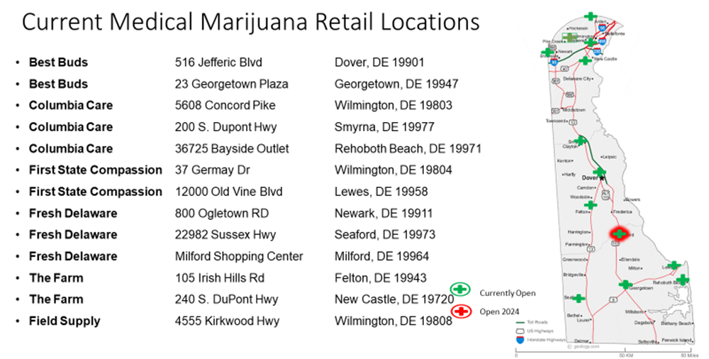
Medical Marijuana Program (MMP)
13
6- Licensed Operators in OMM combine for 13 retail locations
5 have cultivation - 4 have manufacturing
Notes:
There are six licensed companies, five have active cultivation facilities, four have active manufacturing facilities, and combined there are 13 active retail locations, most recent opened in Milford, Delaware in May 2024.

Slide 12
Lottery Process
  Step 1: Drawing scheduled for Thu. 10/24/2024
    If an applicant passes the minimum qualifications review and has paid their application fee, they receive a lottery number generated by the system
    A separate drawing will be conducted for each category of license by County.
    The 10/24/2024 Lottery will include all categories except Open Retail Licenses
    Open Retail License Lottery will be conducted in a December 2024 Lottery Drawing
  Step 2: The Lottery Drawing –
    will be broadcast on Facebook Live but will only reveal the selected Lottery Number.
    The selected applicants will be officially notified by the OMC in the days following the lottery.
  Step 3: The Selected Applicants Notification
    Once all Selected Applicants have been officially notified the identity of the selected applicants will be shared with the media and the public
  Step 4: The Conditional License
    Selected Applicants will be issued a Conditional License and begin the Supplemental Application Process
  Step 5: The Active License
    The Active License is not issued until the entire process is completed and all requirements of Title 4 § 1354 have been met

Slide 13
My Town & The OMC
§ 1354 Grounds for refusal of license; transfer or extension of premises.
(a) The Commissioner may not grant a license under this chapter in any county or subdivision thereof, if granting a license is contrary to the law of any municipality or county adopted under § 1351 of this title.
(b) The Commissioner may refuse to license an applicant if the Commissioner has substantial evidence that would reasonably support a belief that any of the following apply:
(1) There are sufficient licensed premises in the municipality or county, or the granting of a license in the municipality or county stated in the application is not otherwise demanded by public interest or convenience.
(d) The Commissioner may refuse to grant a license to sell marijuana, marijuana products, or marijuana accessories to any new establishment to be located in the vicinity of a church, school, college or substance abuse treatment facility as defined under § 2203 of Title 16...
(e) The Commissioner shall refuse to grant a license for the sale of marijuana, marijuana products, or marijuana accessories when there is an existing licensed establishment of the same type within 1200 feet by accessible public road or street in any incorporated city or town, or within 1 mile by accessible public road or street in any unincorporated or rural area. …

Slide 14
My Town & The OMC
§ 1354 Grounds for refusal of license (cont’d)
(g) The Commissioner may not grant a new license of any type and may not grant an extension of premises of an existing license of any type unless the application for said new license or for said extension is accompanied by a certificate of compliance from the appropriate political subdivision showing all of the following:
(1) That the premises where the license is to be used are properly zoned for the applicant’s intended use.
(2) That all necessary permits have been approved.
(3) That the applicant has complied with all other applicable licensing requirements of the appropriate political subdivision.
(h) Subsection (g) of this section does not apply to any application for a temporary extension of premises as authorized by Commissioner rule if such application has not been objected to by the appropriate political subdivision and the political subdivision was provided with notice of the application by the applicant within 7 days of the date the application is filed with the Commissioner.

Slide 15


Questions
Commissioner Rob Coupe
Deputy Commissioner Paul Hyland
Director Joe Schlimer, Medical Marijuana Program
Keila Montalvo, Community Relations Officer
Taylor Shannon, Administrative Specialist II
DAG Adria Martinelli, Legal Counsel
Dawn Robinson, Social Equity Program
Website OMC.Delaware.gov
Also on Facebook, Instagram and X

Slide 16
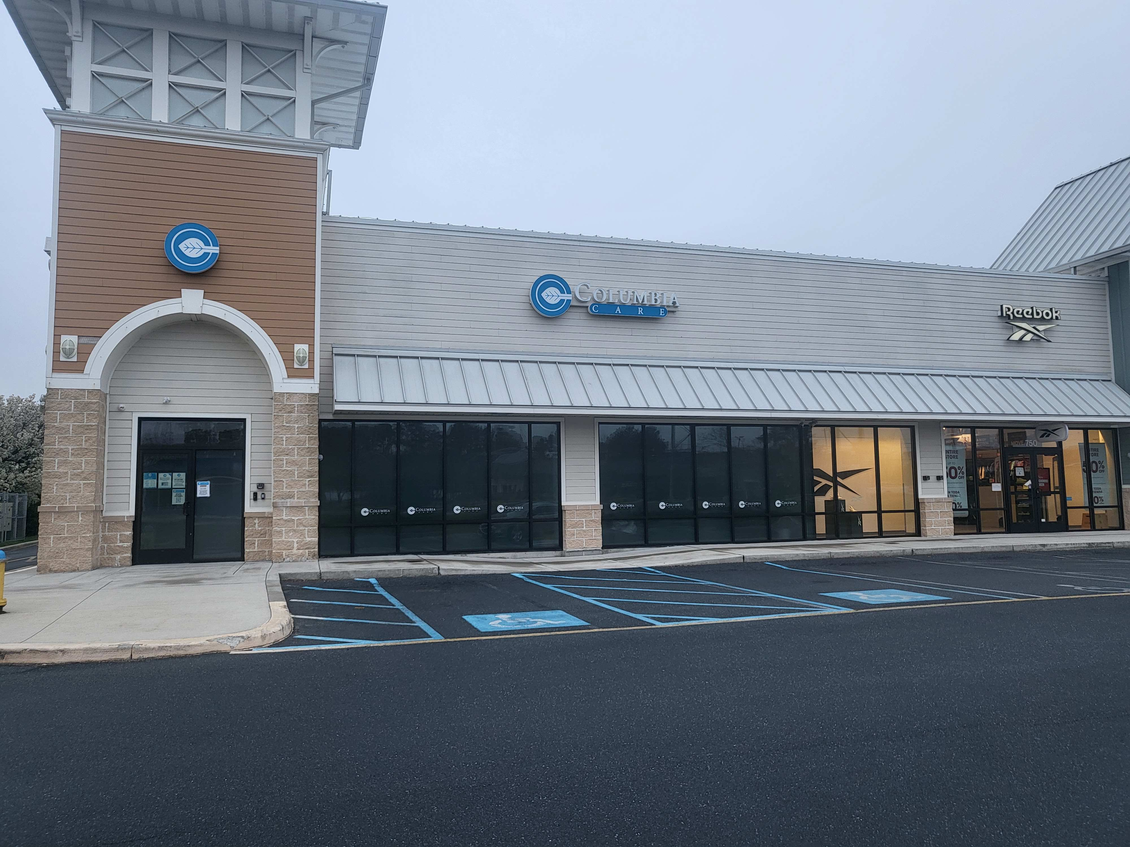
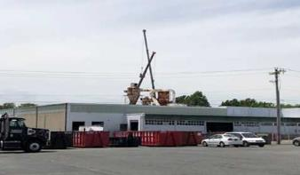
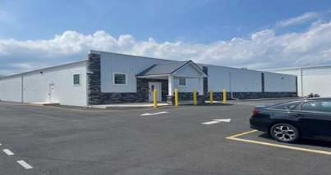
Not in My Town
§ 1351 Local control - A municipality may prohibit the operation of …
Marijuana Use is Legal – it can be used in your jurisdiction
Does the illegal market currently supply marijuana users?
Improving Blighted Areas? Industrial areas?
Medical Card Holders – how many are in your town or jurisdiction?
Will persons with disabilities benefit from having a dispensary nearby?
Would your town benefit from the employment opportunities?
Opportunities for the construction trades and other businesses?
Notes:
-(a) A municipality may prohibit the operation of marijuana cultivation facilities, marijuana product manufacturing facilities, marijuana testing facilities, or retail marijuana stores through the enactment of an ordinance or through an initiated or referred measure.
(b) A municipality or county may enact ordinances or regulations that are not in conflict with this chapter or in conflict with regulations enacted by the Commissioner, governing the time, place, manner, and number of marijuana establishment operations. A municipality or county may establish civil penalties for violation of an ordinance or regulations governing the time, place, and manner that a marijuana establishment may operate in such municipality or county.

Slide 17
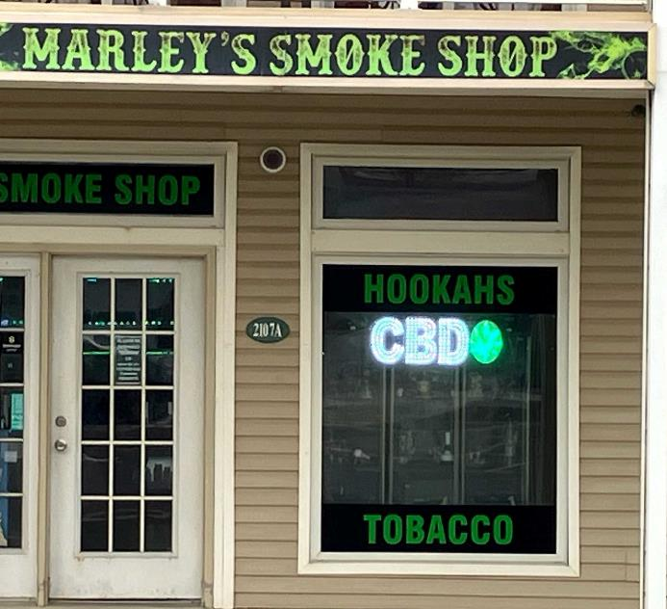
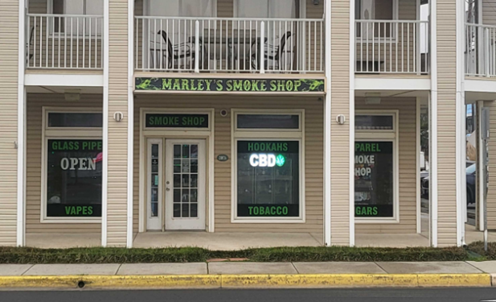
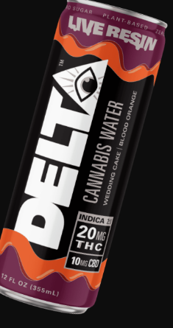
What’s in My Town?
Keep an eye on this developing “gray market”
Hemp based THC infused products
2018 Farm Bill unintentionally created this market
Unregulated after cultivation
Intoxicating hemp products
0.3% THC limit dry weight
delta 8 THC synthesized from CBD
CBD + acid + heat = delta-8 THC
Congress working on a new 5-year authorization…
Notes:
Source Turning Point of Tampa Delta 8 v. Delta 9 THC 8/10/2023

Slide 18
Reference Slides Follow. If needed
§ 1387 Appropriation of revenue.
(b) The funds in the Justice Reinvestment Fund in each fiscal year shall be appropriated to the Criminal Justice Council to administer grants, contracts, services, or initiatives that focus on any of the following:
(1) Restorative justice, jail diversion, workforce development, industry-specific technical assistance or mentoring services for economically-disadvantaged persons in disproportionately-impacted areas.
(2) Addressing the underlying causes of crime, reducing drug-related arrests, and reducing the prison population in this State.
(3) Creating or developing technology to assist with the restoration of civil rights and expungement of criminal records.
(4) Supporting social equity applicants with select business-related expenses.
(5) Supporting or providing reentry services for justice involved individuals.
Any remainder in the Fund at the end of a fiscal year is not subject to reversion.

Slide 19
Funds related to the Marijuana Control Act
Established 15% sale tax
Justice Reinvestment Fund
7% of monthly total tax revenue collected will be
allocated to the Justice Reinvestment Fund
The Criminal Justice Council (CJC) will administer grants, contracts, services or initiatives §1387(b)
Marijuana Social Equity Business Development Fund
Created in the Bond Bill Sect.101 and included $2.0 million in funding from the bond bill. These funds will support the Social Equity Program grant initiative.
Marijuana Regulation Fund
The Office of the State Treasurer shall administer the fund §1381(a)
Notes:
§ 1387 Appropriation of revenue.
(b) The funds in the Justice Reinvestment Fund in each fiscal year shall be appropriated to the Criminal Justice Council to administer grants, contracts, services, or initiatives that focus on any of the following:
(1) Restorative justice, jail diversion, workforce development, industry-specific technical assistance or mentoring services for economically-disadvantaged persons in disproportionately-impacted areas.
(2) Addressing the underlying causes of crime, reducing drug-related arrests, and reducing the prison population in this State.
(3) Creating or developing technology to assist with the restoration of civil rights and expungement of criminal records.
(4) Supporting social equity applicants with select business-related expenses.
(5) Supporting or providing reentry services for justice involved individuals.
Any remainder in the Fund at the end of a fiscal year is not subject to reversion.

Slide 20
Other topics….
DTCC Marijuana Industry Training Program – Workforce Development January 2025
Testing Project with DSP of the products from the illegal market to compare to the standards in the regulated market
OMC FAQs page at our website omc.delaware.gov
How do I know the marijuana products I buy are safe?
  To reduce the risk of consuming dangerous substances from marijuana, it is important to buy marijuana from a State of Delaware regulated business. To protect the public, all marijuana grown in Delaware undergoes a rigorous testing protocol to detect mold, bacteria, yeast, pesticides, solvents, and heavy metals testing.
DATA & METRICS- what data points should be studied by the State?
  Employment impact?
  Crime and Drug Use?
  Economic Impact?
  Highway Safety?
  Health and Safety? E.R. Visits?
omc.delaware.gov

