Slide 1
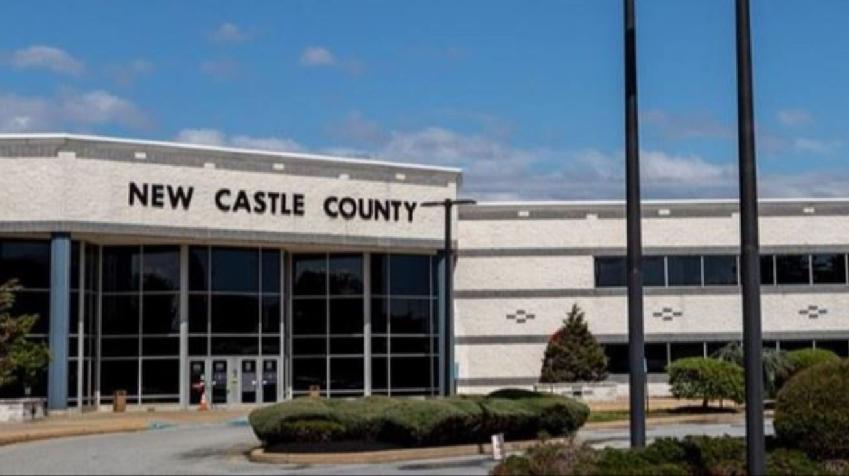
Overview of the New Castle County Police Accountability Board

Slide 2
functions
The NCCPAB was created by County Ordinance 23-148.
The Board advises the Department of Public Safety and the Division of Police on policy, training, and other issues relating to or affecting the department and the communities served by the department. Additionally, the Board shall:
Conduct community outreach and hold public forums to solicit public feedback;
Review and provide recommendations regarding police policies and procedures, including police misconduct complaints, discipline, use of force, recruiting practices, and crime prevention strategies. The review of misconduct complaints, discipline, and use of force will include only information permitted by Delaware law;
Offer constructive criticism to improve police-community relations;
Review and analyze data and information regarding arrest data and police misconduct data; and
Provide recommendations on future police reform.

Slide 3
composition
The Board includes 11 voting members and 2 non-voting members. 8 of the voting members are recommended by outside organizations.
Social service organizations shall submit nominees for two (2) members of the community who have been impacted directly or are immediate family members or caregivers of those impacted by the juvenile or adult criminal justice system;
Civil rights organizations shall submit nominations for two (2) criminal justice reform advocates;
Faith-based organizations shall submit a nomination for one (1) religious leader from the community who has experience with justice-involved individuals;
Education organizations shall submit a nomination for one (1) member of the education community;
Mental health organizations shall submit a nomination for one (1) member from the mental health treatment community as defined by the National Alliance on Mental Illness;
Victims’ rights organizations shall submit a nomination for one (1) member of the victims’ rights community who was a victim or relative of a victim of violent crime;
and three (3) at-large members.
The NCCPAB has two staff members:
Executive Assistant
Attorney

Slide 4
There is no right answer as to what an effective police oversight body “must” look like.
Keys to Oversight per NACOLE
Keys to effective police oversight per NACOLE:
Independence
Adequate Funding
Access to information
Rapport
Ample Authority
Ability to Review
Community Support/Outreach
Transparency

Slide 5
Plus/delta analysis

Slide 6
pluses
(what’s working)
Community referral process for Board Members
Quarterly public forums
Board Committees
YouTube Channel
National Association for Civilian Oversight of Law Enforcement (NACOLE) Membership

Slide 7
deltas
(challenges)
Lack of transparency due to State law
Processing civilian feedback
Time constraints
Budget

Slide 8
Community events
When: June 2024
Where: Rosehill Community Center (New Castle)
Roundtable Discussion
When: August 2024
Where: Leasure Elementary School (Bear)
Know Your Rights Training
When: December 8, 2024
Where: Chase Fieldhouse (Wilmington)
Community vs. Police Basketball Game

Slide 9
Questions?
Kailyn Richards, Executive Assistant NCC Police Accountability Board
Kailyn.Richards@newcastlede.gov
302-395-5053

