Slide 1
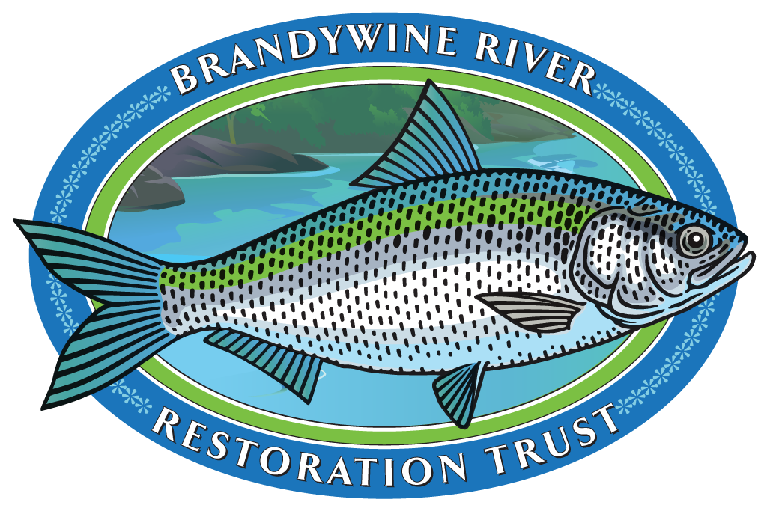
Resolution for Temporary Easement for Removal of Dam #6

Slide 2
AGENDA
Brandywine River Restoration Trust
Benefits of Dam Removal
Easement for Removal of Dam 6

Slide 3
BRRT MISSION
Restore and protect the Brandywine River to enable migration of American Shad and improve ecological function while providing equitable opportunity for environmental education and recreation

Slide 4
BRRT Founding Members

Slide 5
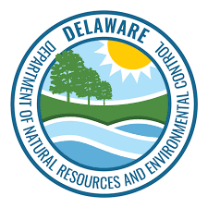
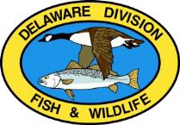
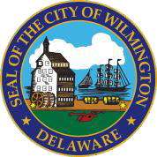
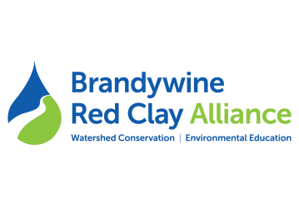
BRRT Partners
CBR4

Slide 6
BRRT Sponsors

Slide 7
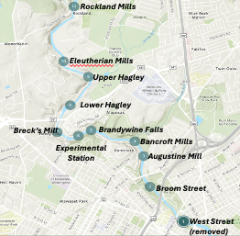
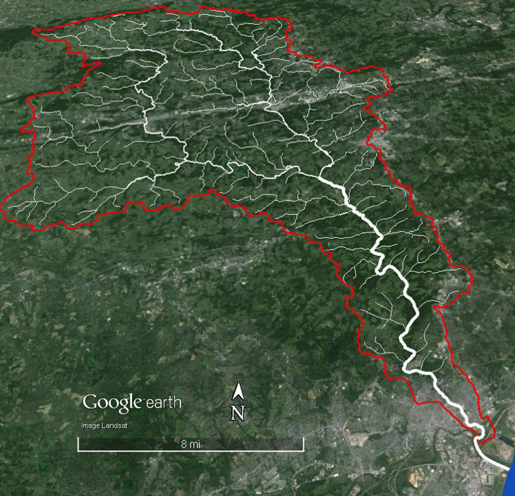
Brandywine Watershed & Delaware Dams
ROUTE 30
WATER
WATER

Slide 8
Flooding on the Brandywine
Brandywine has been flooding for centuries
Brandywine dams increase flood levels
Floods are becoming more frequent and more severe due to climate change
Removing dams is part of a multi-year, multi-agency effort to reduce flooding

Slide 9
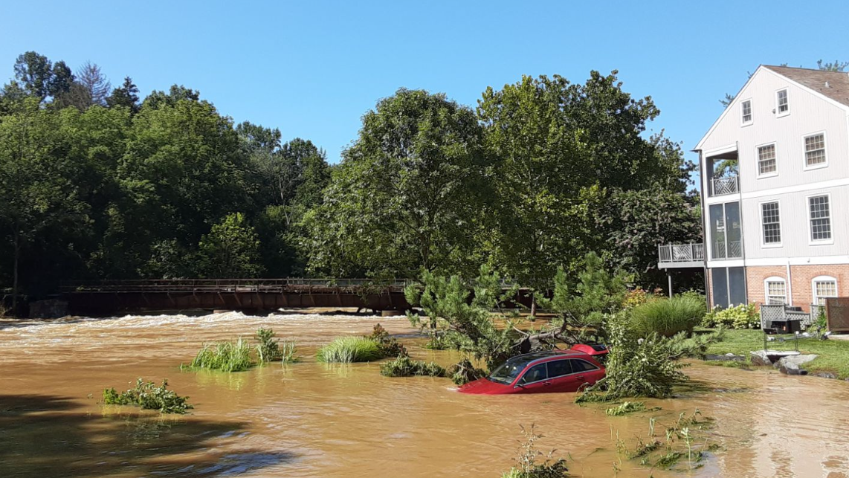
Hurricane Ida: September 2, 2022
Dam 11
Rockford Falls

Slide 10
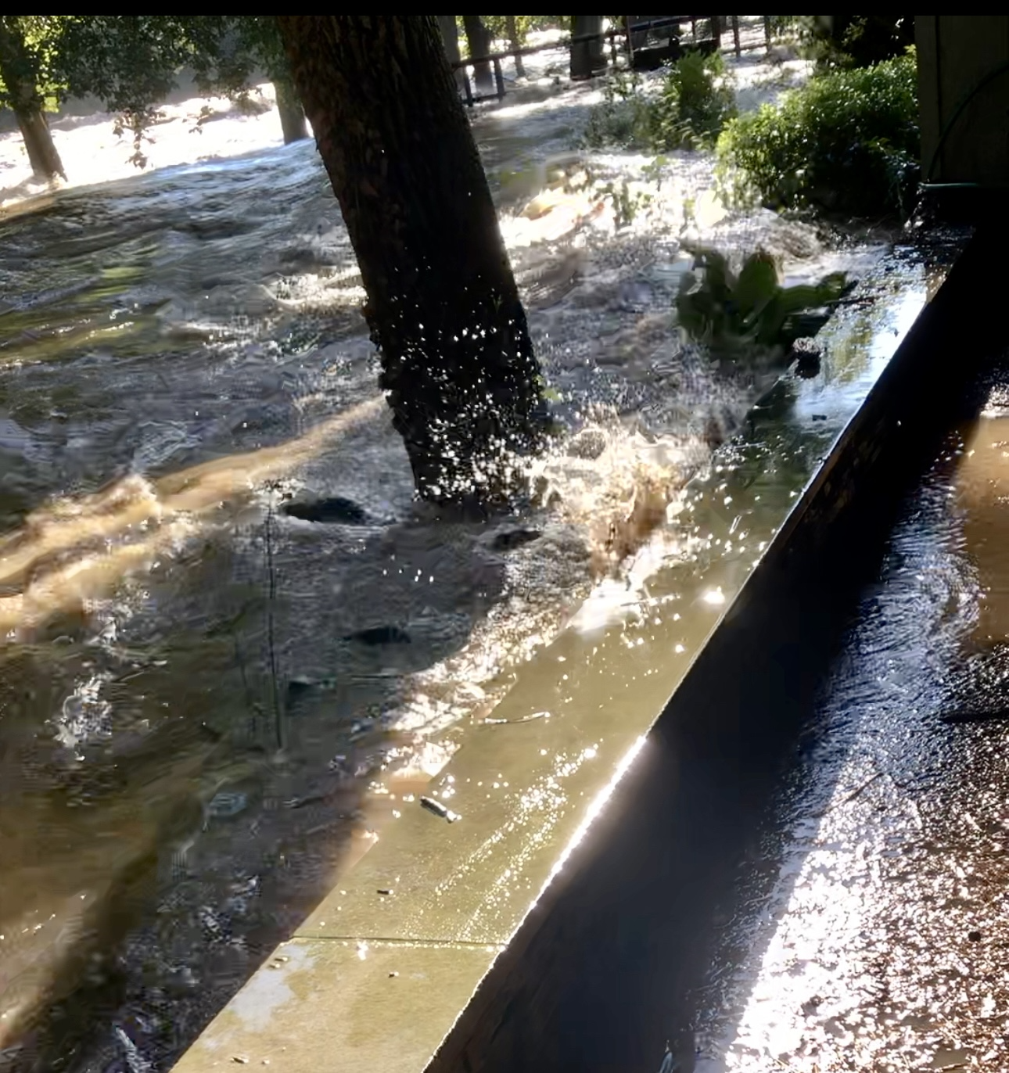
Dam 5
Brandywine Falls

Slide 11
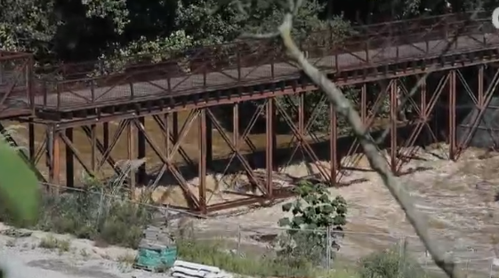
Bancroft Mills
Alapocas Bridge

Slide 12
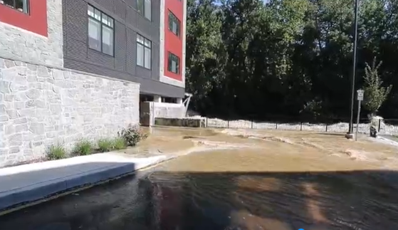
Dam 4
The Falls Apartments

Slide 13
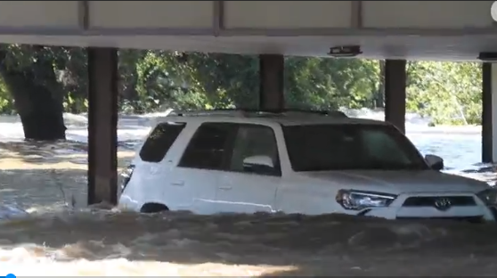
Dam 3
3 Mill Road

Slide 14
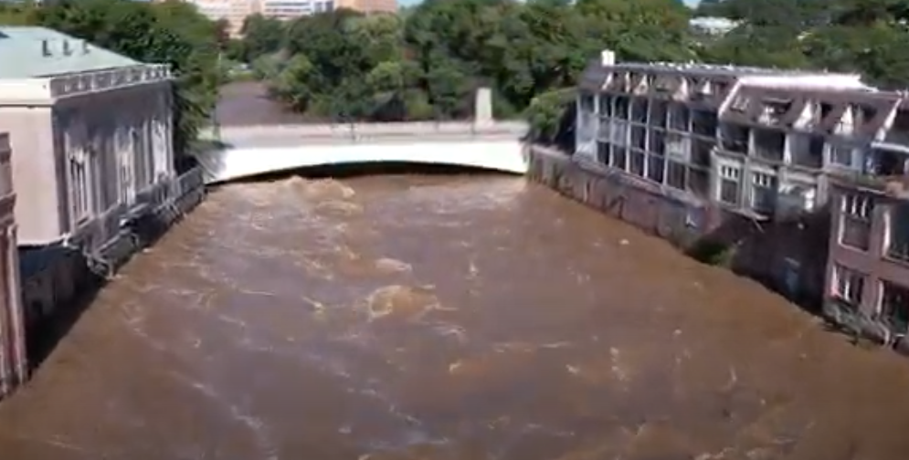
Superfine Lane Condos

Slide 15
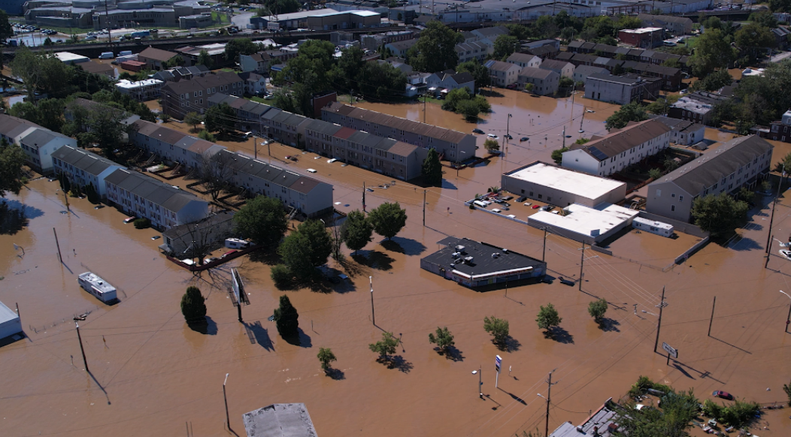
Northeast Wilmington

Slide 16
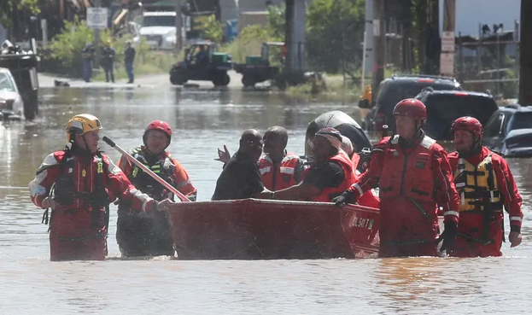
Northeast Wilmington

Slide 17
Brandywine Park January 10, 2024

Slide 18
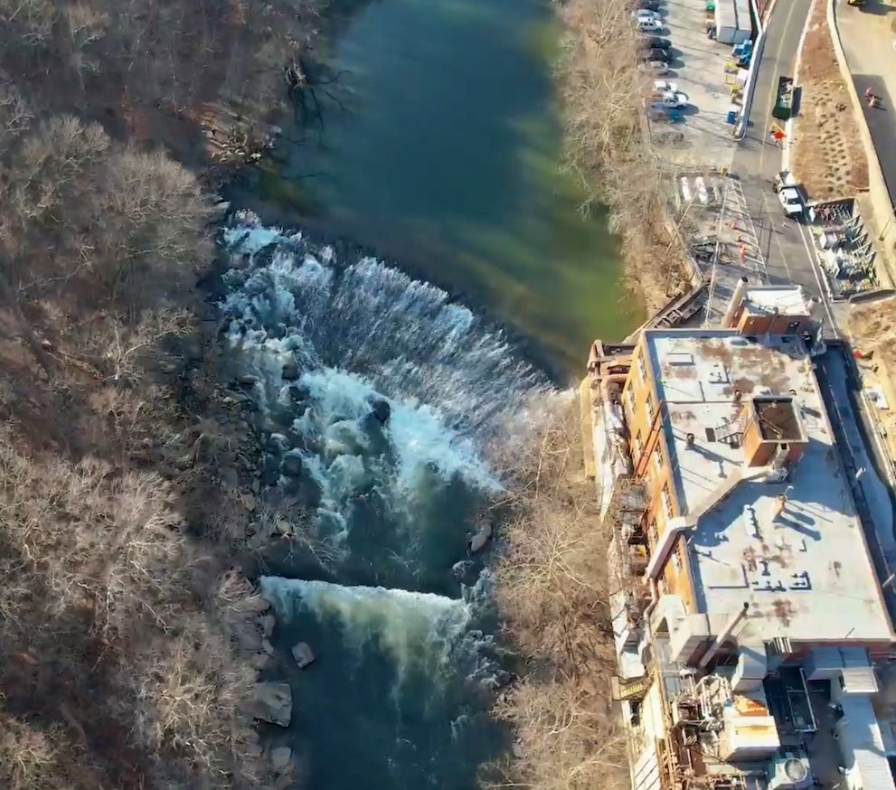
Dam 6: DuPont Experimental Station
Half Owned by City
Half owned by DuPont
Floods Experimental Station
US Army Corp of Engineers DNREC, City of Wilmington
Funded by DuPont and State

Slide 19
Easement is for Dam 6
NOT for Dam 4 or Dam 5
Experimental Station
5
Alapocas Park
6
4
Rockford Park

Slide 20
Benefits of Removing Dams
Reduces Flooding
Improves Public Safety
Restores American Shad
Increases Ecological Diversity
Improves Water Quality
Increases Recreational Use

Slide 21
Baby Shad Swimming to Atlantic Ocean

