Slide 1
A COMMUNITY
FREE OF HUNGER

Slide 2
OUR MISSION
Our mission is to inspire hope in our communities by providing food to nourish Delawareans, while collaborating on long-term solutions to hunger and poverty.
WHO WE ARE

Slide 3
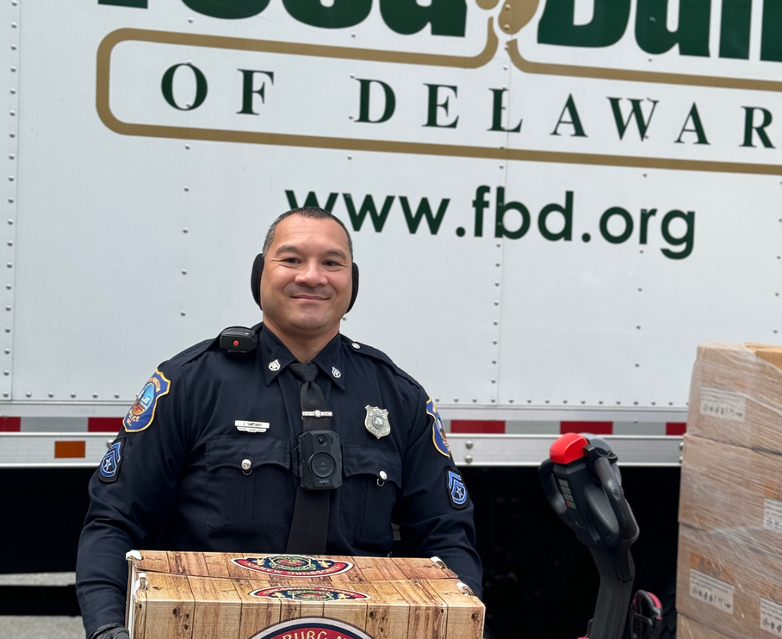
WHY WE
ARE NEEDED
1 in 8 Delawareans is food insecure
1 in 5 Delaware children is food insecure

Slide 4
FOOD SECURITY
Access by all people at all times to enough food for an active, healthy life
HUNGER
WHAT IS FOOD INSECURITY?
Hunger is a “personal, physical sensation of discomfort.”
FOOD INSECURITY
Food insecurity is “the lack of available financial resources for nutritionally adequate food at the household level.”

Slide 5
WHO IS FOOD INSECURE?
SENIORS
CHILDREN
WORKING POOR
AND MANY OTHERS... FAR TOO MANY DELAWAREANS ARE ONE PAYCHECK AWAY FROM NEEDING THE SERVICES OF THE FOOD BANK

Slide 6
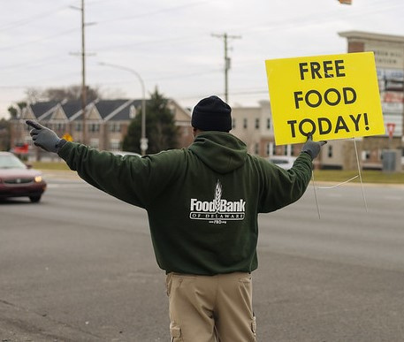
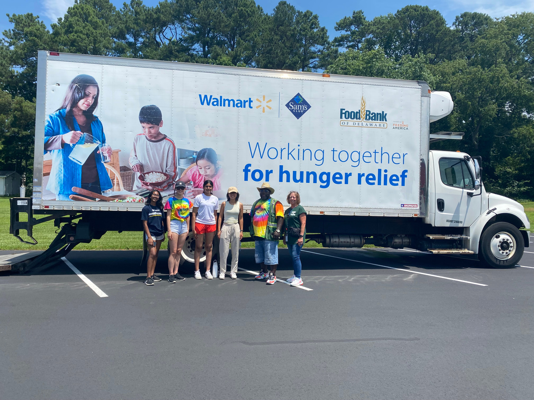
SOME CHALLENGES OUR NEIGHBORS EXPERIENCE
High cost of childcare
Inflation = high costs across the board, especially groceries
Lack of affordable housing
Medical expenses

Slide 7
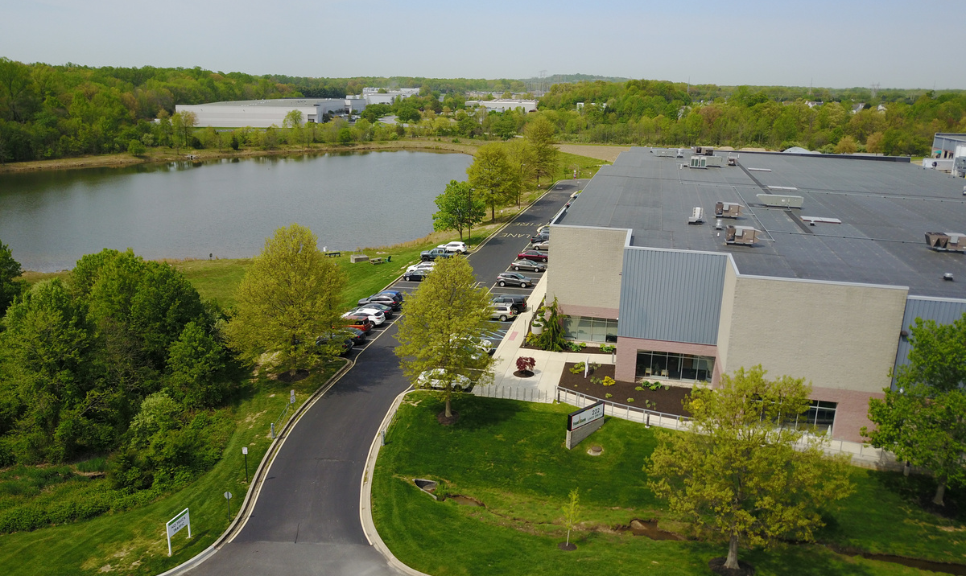
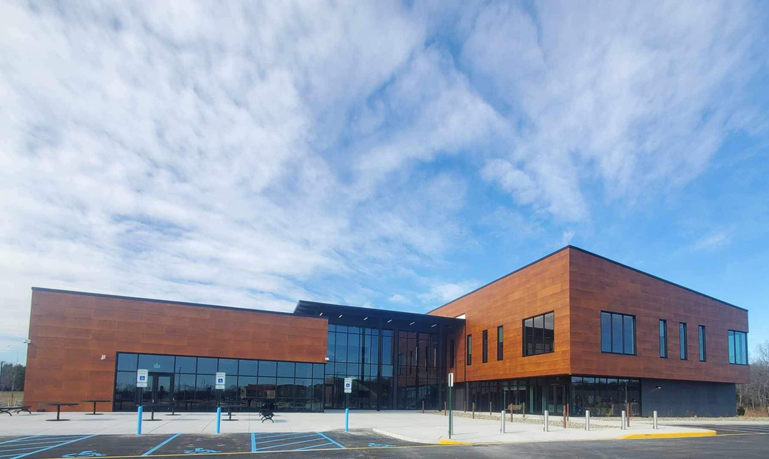
HOW DO WE MEET THE DEMAND?
Large facilities enabled us to distribute 19.5 million meals last year and change many lives
Partnerships
Generous community
Newark facility:
80,000-square-feet
Milford facility:
70,000-square-feet

Slide 8
FOOD FOR TODAY...
FOOD FOR TOMORROW...
FOOD DISTRIBUTION
PROGRAMS
WORKFORCE & COMMUNITY DEVELOPMENT
PROGRAMS

Slide 9
FOOD FOR TODAY

Slide 10
PARTNER
FOOD CLOSETS
WEEKEND BACKPACK PROGRAM
HEALTHY
PANTRY CENTERS
HOW WE
DISTRIBUTE
FOOD
MOBILE PANTRY PROGRAM
HOME DELIVERY PROGRAM
SENIOR
NUTRITION PROGRAM

Slide 11
Provide food to close to 200 organizations throughout the state.
Distributed more than 6 million pounds last year = 7.4 million meals
Partners include emergency food closets, shelters, soup kitchens, school pantries and more.
Some you may know:
YWCA
Ministry of Caring
St. Patrick’s Center
Salvation Army
PARTNER
FOOD CLOSETS

Slide 12
Weekend and holiday meals for kids when school is not in session.
Distributed on Fridays or the last day before a holiday.
Teacher or other school official discreetly places the bag in the child’s backpack
Distributed 302,483 meal kits through 197 schools/ daycares last year
BACKPACK
PROGRAM

Slide 13
On-site food pantry at the Food Bank in Newark and Milford
Choice food pantries
Nonperishable items, meats, produce, dairy
46,961 visitors last year
HEALTHY PANTRY CENTER

Slide 14
Food Bank partners with organizations throughout the state
Most distributions are held as a drive-thru
Nonperishables and perishable items are loaded into vehicles
Held 513 mobile pantries last year - 49,796 visitors
4 million pounds distributed or 4.9 million meals
MOBILE
PANTRY

Slide 15
Nonperishable food delivered by Amazon Flex drivers once per month
Intended for households who are homebound, lack transportation or cannot get to food pantries
Box contains nonperishable food items
Last year we made 17,116 deliveries
HOME DELIVERY

Slide 16
Monthly food distribution for Delaware seniors over the age of 60
Boxes contain nonperishable items and supplemental items when available
Pick up available at 44 statewide sites
Sponsored by the United States Department of Agriculture
Distributed 17,238 meal boxes last year
SENIOR
NUTRITION
PROGRAM

Slide 17
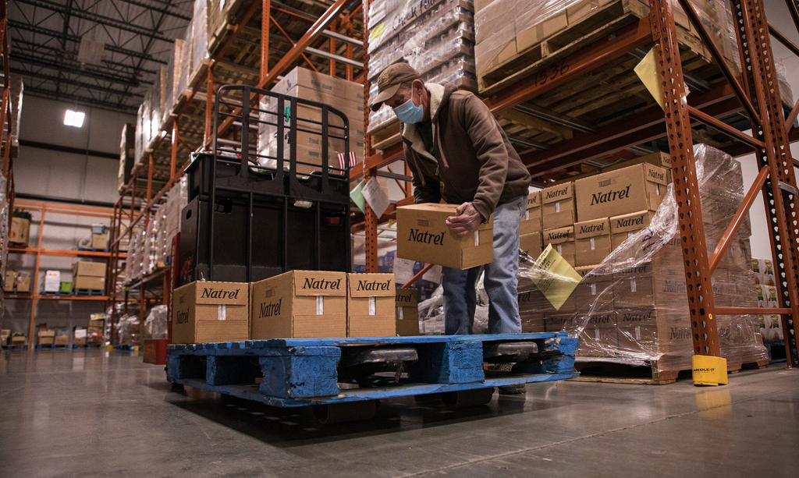
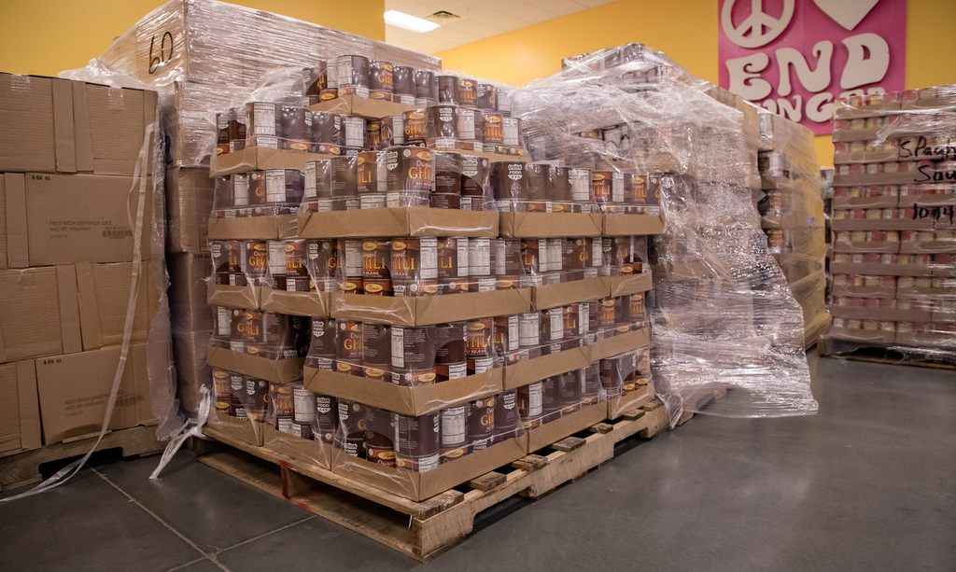
WHERE DO WE GET ALL OF THE FOOD?
Community food drives
Donations from manufacturers
Wholesale food purchasing
Retail store donations
United States Department of Agriculture
Farmers
Food Bank Farm/Garden

Slide 18
Operate a 5-acre farm at the Food Bank in Newark
Operate a 3.5-acre garden at the Milford facility
Harvested 17,992 pounds of fresh produce last year
Managed by team of 4 staff members plus volunteers
Grow year round
FOOD BANK FARM/ GARDEN

Slide 19
FOOD BANK FARM/GARDEN

Slide 20
FOOD FOR TOMORROW

Slide 21
WORKFORCE & COMMUNITY DEVELOPMENT
NUTRITION
EDUCATION
BENEFITS
OUTREACH
SPECIALIZED
TRAINING
EMPLOYMENT
PROGRAM
$TAND BY ME
FINANCIAL COACHING
JOB TRAINING -
FOOD SERVICE/
WAREHOUSING

Slide 22
Nutrition education sessions offered to seniors, adults and children
Provide recipes using commonly found items in food pantries
Cooking demonstrations
Help partner food pantries set up their shelves so neighbors make healthy choices
NUTRITION
EDUCATION

Slide 23
Provide outreach to neighbors about benefits they may be eligible for
SNAP
Medicaid
Purchase of Care
Long-term Care
In addition to outreach, we also walk neighbors through the application process
These benefits can help free up money in monthly budgets to help cover other costs
BENEFITS
OUTREACH

Slide 24
Partnership with the State of Delaware and United Way of Delaware to house financial coaches at local organizations
We have two financial coaches on our team
Assist with
Identifying financial goals
Mapping out a plan of action
Creating a working budget
Developing new habits and breaking old ones
Dealing with collectors
Eliminating debt
STAND BY ME FINANCIAL COACHING

Slide 25
The Culinary School
14 week training program
12 weeks of classroom/kitchen instruction + 2 week paid work experience
Certified trade school by the Delaware Department of Education
Students come from all walks of life. Many are looking for a second chance
Learn the ins and outs of the food service industry
JOB TRAINING
CULINARY ARTS

Slide 26
The Kitchen School
12 week training program for adults with disabilities
8 weeks of classroom/kitchen instruction + 4 week work experience with Food Bank job coaches
Train students to enter food-service workplaces using national industry-based curriculum
Students receive support and develop an individualized plan needed to enter a workplace, including transportation options
JOB TRAINING
CULINARY ARTS

Slide 27
L.O.G.I.C. (Logistics, Operations, General Warehousing and Inventory Control
14 week warehousing/logistics training program
Learn the ins and outs of a working warehouse, including how to use warehouse equipment
Life skills training
Students have the opportunity to earn four certifications
OSHA-10
Forklift
Certified Logistics Associate Certified Logistics Technician
JOB TRAINING
WAREHOUSING/
LOGISTICS

Slide 28
S.T.E.P.
Fosters diversity and inclusiveness by empowering and employing people with disabilities within our organization.
We met with directors to determine tasks and identified the following employment opportunities:
Cafe
Healthy Pantry Center
Farm/Garden
Office Support
Warehouse/Inventory
Facilities
SPECIALIZED TRAINING EMPLOYMENT PROGRAM
(S.T.E.P)

Slide 29
HANDS-ON TRAINING AT THE FOOD BANK CAFES

Slide 30
HOW TO GET INVOLVED
VOLUNTEER
On the Farm
In the Garden
Healthy Pantry Center
Volunteer Room
Mentor Students
Mobile Pantries
DONATE
Food drives
Fundraisers
Special events
$1 = 3 meals
OTHER WAYS
Dine in the cafe
Soup sale
Catering
www.fbd.volunteerhub.com

Slide 32
GET IN TOUCH
Chad Robinson
crobinson@fbd.org
www.fbd.org

